Slide 1
Session 03: Access
MIS 6311-501 Cyber Security Fundamentals
Chris Davis

Slide 2
Housekeeping
Any Questions? Please do not hesitate to email. Or text.
Class Website: https://elearning.utdallas.edu
Dropbox: https://goo.gl/9AFyoE
UTD Email: cmd140430@utdallas.edu
Gmail: davischr2@gmail.com
Google Voice: 214-771-8122 (Text & Emergencies)
LinkedIn: www.LinkedIn.com/in/ChristopherDavis
Blog: www.cloudauditcontrols.com
Class: Monday 7:00pm-9:45pm JSOM 12.210

Slide 3
Academic Calendar & Sessions

Slide 4
Comparison of Our Class to CISSP Domains
Shon Harris Book – Chapters
Current CISSP Domains
2
Information Security Governance and Risk Management
8
Business Continuity and Disaster Recovery Planning
Security and Risk Management
9
Legal, Regulations, Investigations and Compliance
7
Cryptography
Security Engineering
4
Security Architecture and Design
Security Assessment and Testing
5
Physical (Environmental) Security
Asset Security
6
Telecommunications and Network Security
Communications and Network Security
3
Access Control
Identity and Access Management
11
Operations Security
Security Operations
10
Software Development Security
Software Development Security

Slide 5
Tales from the Crypt.
Practical Applications & Lessons Learned.

Slide 6

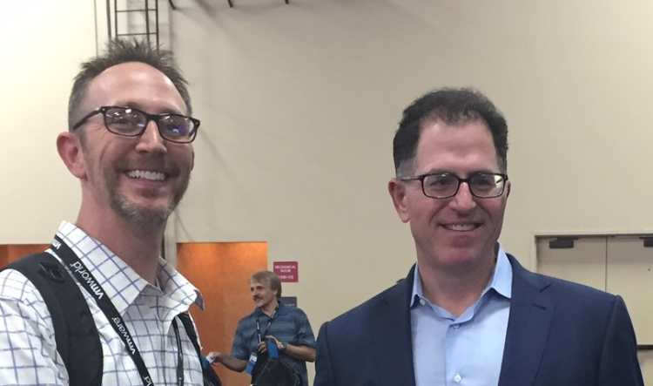
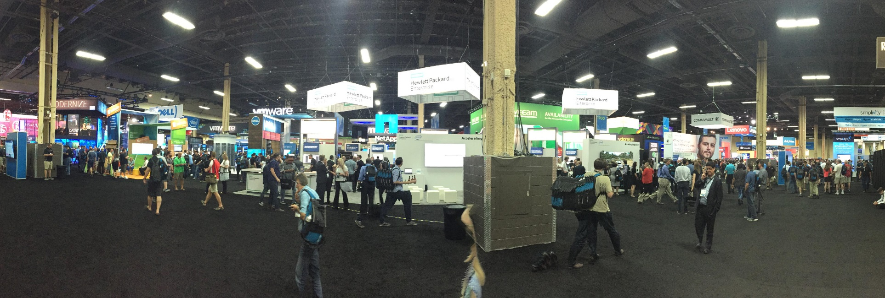

Slide 7
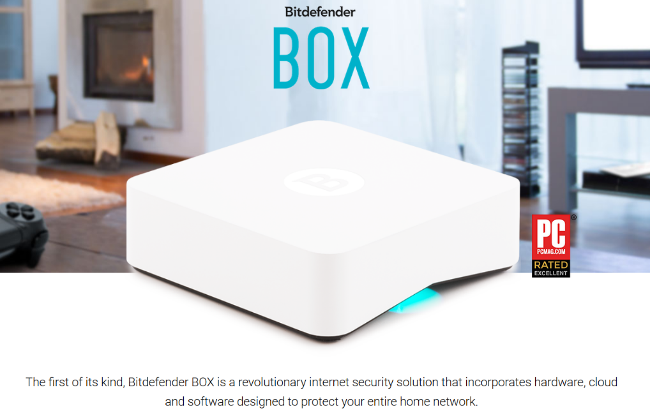
http://www.bitdefender.com/box/

Slide 8
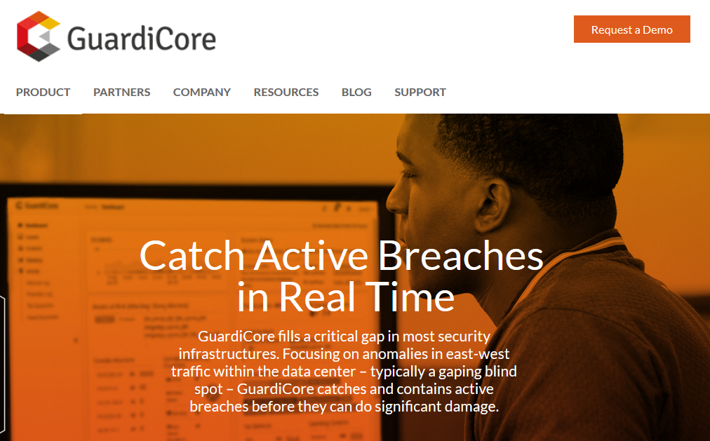
https://www.guardicore.com/product/

Slide 9
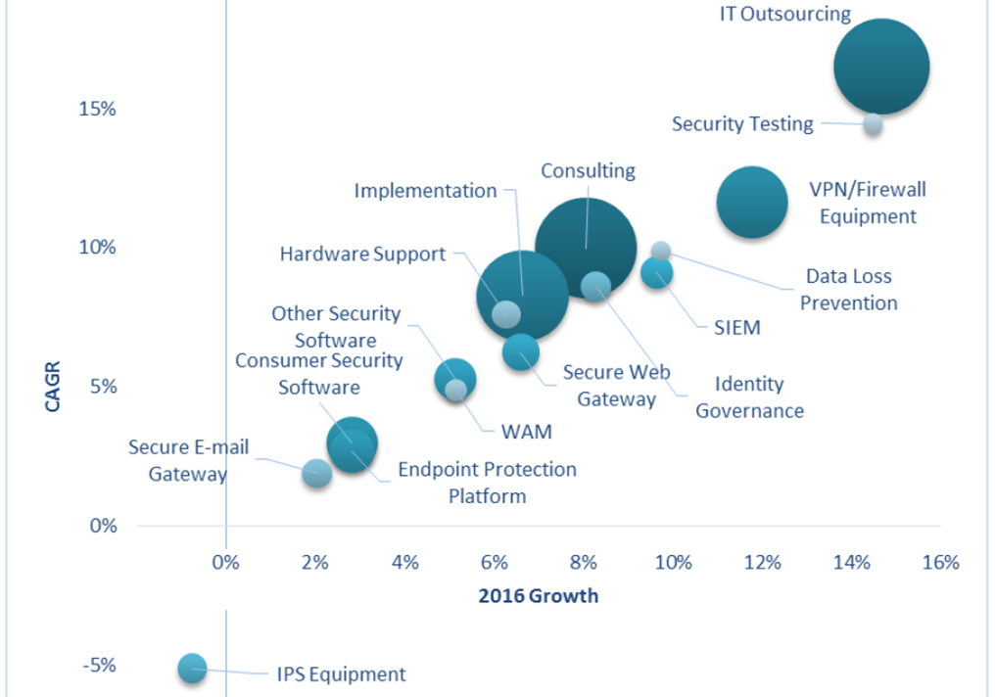
IT Spending Forecast, 4Q15 Update: What Will Make Headlines in 2016?
2016 Security spend exceeds $84.3 billion!
Market Trends
Secure Cloud/SaaS
Behavioral Analysis
Algorithmic Security
IoT
Analytics
Intel Sharing
http://www.gartner.com/webinar/3178622

Slide 10
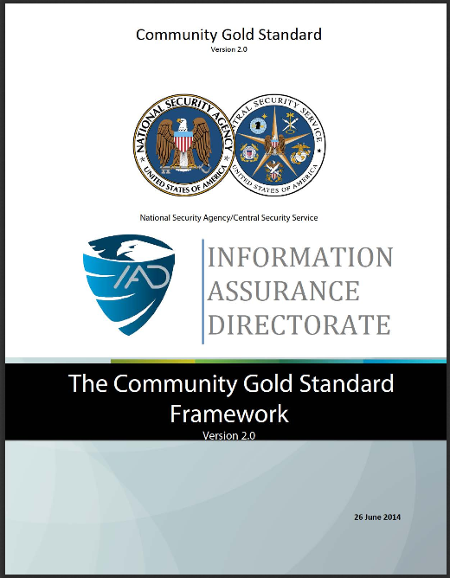
Interesting NSA white paper on Gold Standard Framework
3.6 Identity Management
3.6.1 Create an Issue Unique Identifiers
3.6.2 Distribute Unique Identifiers
3.6.3 Maintain Unique Identifiers
3.7 Attribute Management
3.7.1 Establish Secure Attributes
3.7.2 Publish Attributes
3.7.3 Maintain and Update Attributes
3.8 Credential Management
3.8.1 Create an Issue Credentials
3.8.2 Maintain Credentials
3.9 Logical Access Control
3.9.1 Resource Authentication
3.9.2 Resource Authorization
https://www.iad.gov and search for community-Gold-Standard

Slide 11
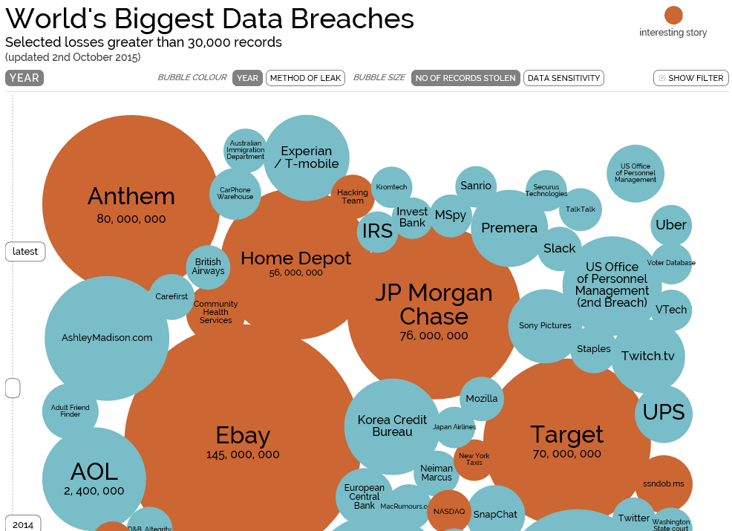
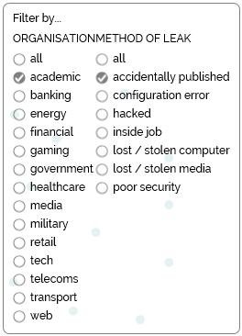
http://www.informationisbeautiful.net/visualizations/worlds-biggest-data-breaches-hacks/

Slide 12
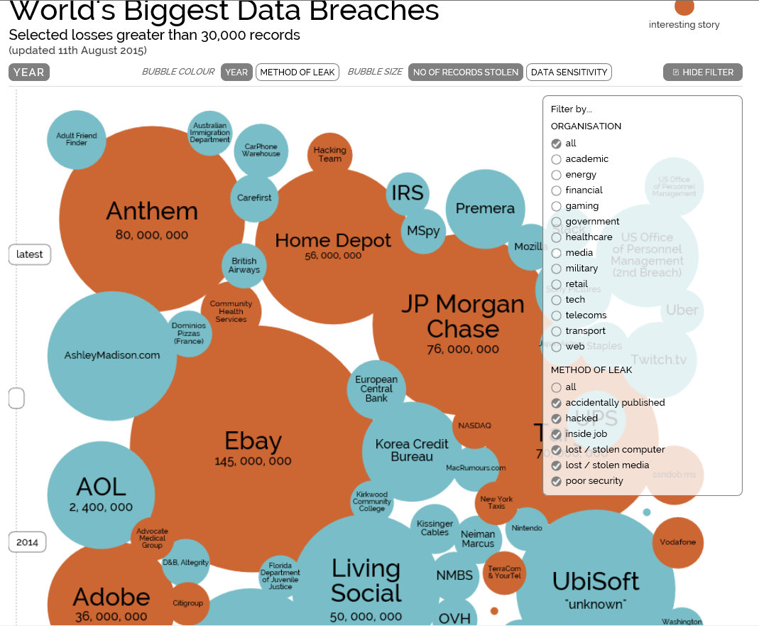
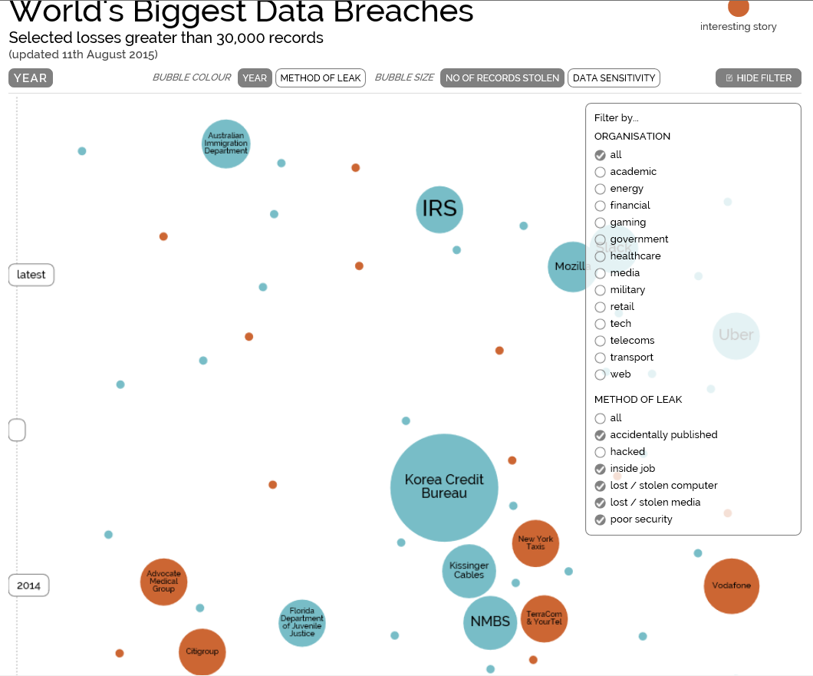
http://www.informationisbeautiful.net/visualizations/worlds-biggest-data-breaches-hacks/

Slide 13
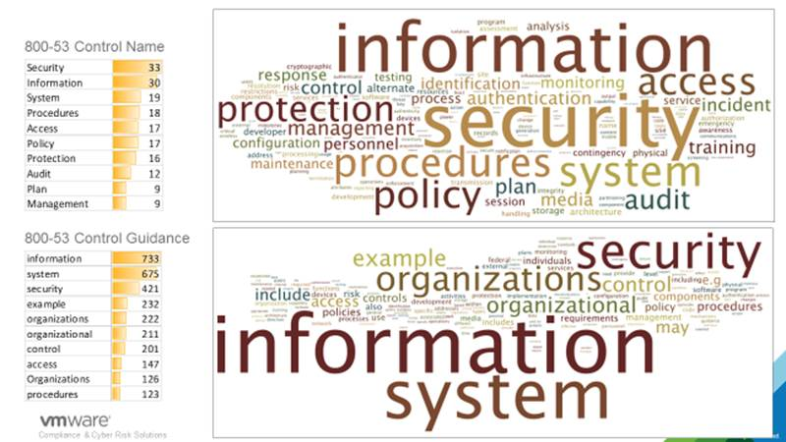

Slide 14
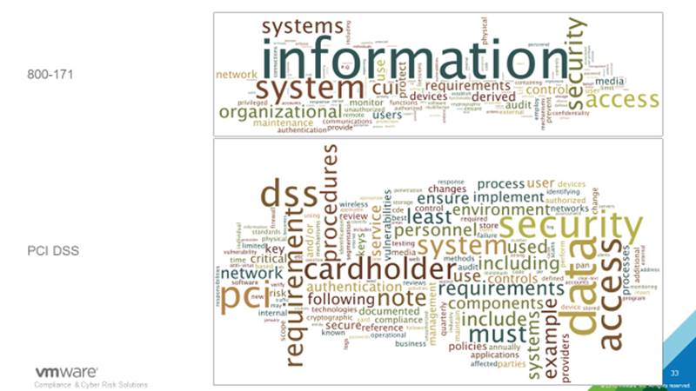

Slide 15
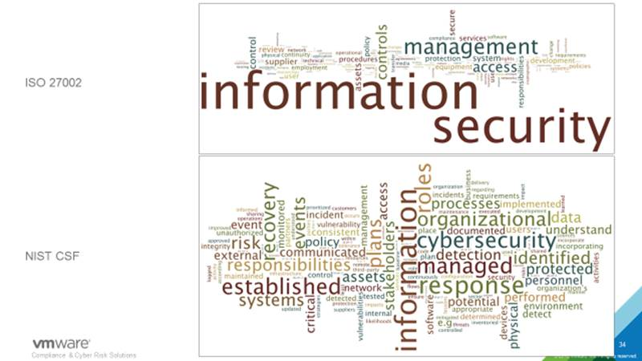

Slide 16
Let’s Get Started.

Slide 17
Chris's View

Slide 18
Access Controls

Slide 19
Session Contents
This session presents the following:
Identification methods and technologies
Authentication methods, models, and technologies
Discretionary, mandatory, and nondiscretionary models
Accountability, monitoring, and auditing practices
Emanation security and technologies
Intrusion detection systems
Threats to access control practices and technologies

Slide 20
Real-World Problems
What should each user have access to?
Who approves and allows access?
How do the access decisions map to policies?
Do former employees still have access?
How do we keep up with our dynamic and ever-changing environment?
What is the process of revoking access?
How is access controlled and monitored centrally?
Why do employees have eight passwords to remember?
We have five different operating platforms. How do we centralize access when each platform (and application) requires its own type of credential set?
How do we control access for our employees, customers, and partners?
How do we make sure we are compliant with the necessary regulations?
Where do I send in my resignation? I quit.

Slide 21
Defining Access Controls
Access controls are security features that control how users and systems communicate and interact with other systems and resources.
They protect the systems and resources from unauthorized access and can be components that participate in determining the level of authorization after an authentication procedure has successfully completed.
Although we usually think of a user as the entity that requires access to a network resource or information, there are many other types of entities that require access to other network entities and resources that are subject to access control.

Slide 22
Defining Subject and Object
Access is the flow of information [that must be controlled] between a subject and an object.
A subject is an active entity that requests access to an object or the data within an object. A subject can be a user, program, or process that accesses an object to accomplish a task. When a program accesses a file, the program is the subject and the file is the object.
An object is a passive entity that contains information or needed functionality. An object can be a computer , database, file, computer program, directory, or field contained in a table within a database.
When you look up information in a database, you are the active subject and the database is the passive object.

Slide 23
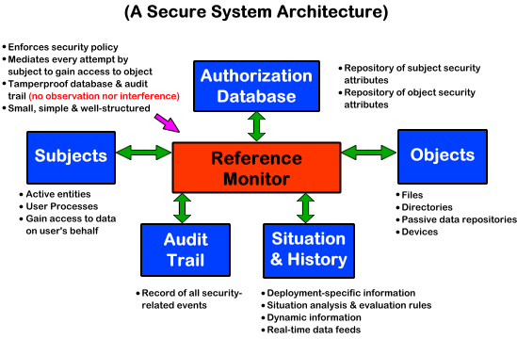
Introduction to the Reference Monitor

Slide 24
Security Principles – CIA Triad
Confidentiality
Confidentiality is the assurance that information is not disclosed to unauthorized individuals , programs, or processes.
Integrity
Information must be accurate, complete, and protected from unauthorized modification. When a security mechanism provides integrity, it protects data, or a resource, from being altered in an unauthorized fashion.
Availability
Information, systems , and resources must be available to users in a timely manner so productivity will not be affected.

Slide 25
Components of Access Control
Identification
Subjects supplying identification information
Username, user ID, account number
Authentication
Verifying the identification information
Passphrase, PIN value, biometric, one-time password, password
Authorization
Using criteria to make a determination of operations that subjects can carry out on objects
“I know who you are, now what am I going to allow you to do?”
Accountability
Audit logs and monitoring to track subject activities with objects

Slide 26
Access Controls Provide 3A
Logical (technical) access controls are used to provide Identification, Authentication, Authorization and Auditing.
They are software components that enforce access control measures for systems, programs, processes, and information. The logical access controls can be embedded within operating systems , applications, add-on security packages, or database and telecommunication management systems.
Things like smartcards, biometrics, passwords, and audit systems are all logical access controls.

Slide 27
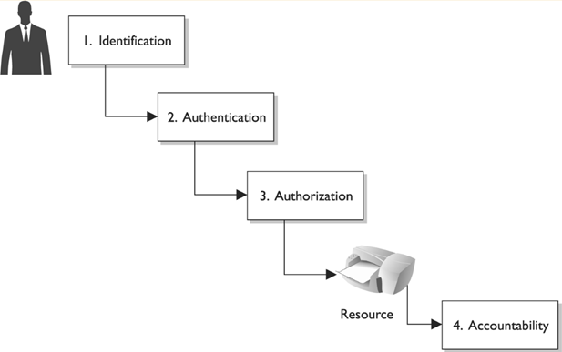
Components of Access Control

Slide 28
Identification
Identifies a user uniquely
Identification must be unique for accountability
Standard naming schemes should be used
Identifier should not indicate extra information about user (like job position)

Slide 29
Authentication
Proving who you say you are, usually one OR MORE of these 3
Something you know
Something you have
Something you are

Slide 30
Strong Authentication
Strong Authentication is the combination of 2 or more of these and is encouraged!
Strong Authentication provides a higher level of assurance
Strong Authentication is also called multi-factor authentication
Something that you know
Something that you are
Something that you have

Slide 31
Authorization
The concept of ensuring that someone who is authenticated is allowed access to a resource.
Authorization is a preventative control*

Slide 32
Accounting or Auditing
Logging and reviewing accesses to objects.
What is the purpose of auditing?
Auditing is a detective control*

Slide 33
Identity Management

Slide 34
Identity Management
Identity management products are used to identify, authenticate and authorize users in an automated means.

Slide 35
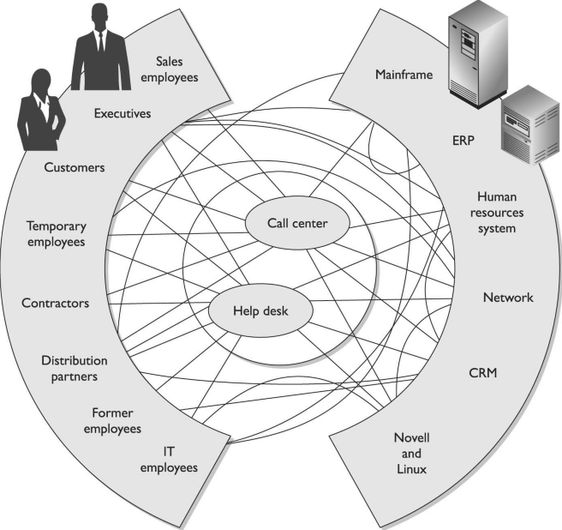
Identity Management IS HARD.
It’s a broad term.
Analogy of four blind men trying to describe an elephant.
Subjects
Objects

Slide 36
Identity Management
May include:
Directories
User account management
Profiles
Access controls
Password management
Single Sign on
Permissions

Slide 37
Directories
Information about the users and resources
LDAP / Active Directory
NIS/YP
Novell Netware
Most enterprises have some type of directory that contains information pertaining to the company’s network resources and users.
Most directories follow a hierarchical database format, based on the X. 500 standard, and a type of protocol, as in Lightweight Directory Access Protocol (LDAP), that allows subjects and applications to interact with the directory.
The objects within the directory are managed by a directory service.
The directory service allows an administrator to configure and manage how identification, authentication, authorization, and access control take place within the network and on individual systems.

Slide 38
Directories Role in ID management
Directories are specialized database optimized for reading and searching operations
Important because all resource info, users attributes, authorization info, roles, policies etc can be stored in this single place.
Directories allow for centralized management!
However these can be broken up and delegated. (trees in a forest)

Slide 39
Account Management Software
Attempts to centrally manage user accounts in a centralized and scalable method.
Often include workflow processes that allow distributed authorization. I.e.. A manager can put in a user request or authorize a request, tickets might be generated for a Key card system for their locations, Permissions might be created for their specific needs etc.
Automates processes
Can includes records keeping/auditing functions
Can ensure all accesses/accounts are cleaned up with users leave.

Slide 40
Password Management In ID systems
Allows for users to change their passwords,
May allow users to retrieve/reset password automatically using special information (challenge questions) or processes
Helpdesk assisted resets/retrievals
May handle password synchronization

Slide 41
Federation
Anyone know what a federation is?

Slide 42
Federation
A Federation is multiple computing and/or network providers agreeing upon standards of operation in a collective fashion. (self governing entities that agree on common grounds to easy access between them)
A Federated Identity is an identity and associated entitlements that can be used across business boundaries.

Slide 43
Authentication

Slide 44
Biometrics
Bio -life
Metrics - measure
Biometrics verifies (authenticates) an individuals identity by analyzing unique personal attribute
Require enrollment before being used*
EXPENSIVE
COMPLEX

Slide 45
Biometrics
Can be based on
behavior (signature dynamics) – might change over time
Physical attribute (fingerprints, iris, retina scans)
We will talk about the different types of biometrics later

Slide 46
Biometrics
Can give incorrect results
False negative – Type 1 error (annoying)
False positive – Type 2 error (very bad)
When a biometric system rejects an authorized individual, it is called a Type I error (false rejection rate).
When the system accepts impostors who should be rejected, it is called a Type II error (false acceptance rate).
The goal is to obtain low numbers for each type of error, but Type II errors are the most dangerous and thus the most important to avoid.

Slide 47
CER
Crossover Error Rate (CER)* is an important metric that is stated as a percentage that represents the point at which the false rejection rate equals the false positive rate.
Also called Equal Error Rate
Use CER to compare vendors products objectively
Lower number CER provides more assurance. (3 is better than an 4)

Slide 48
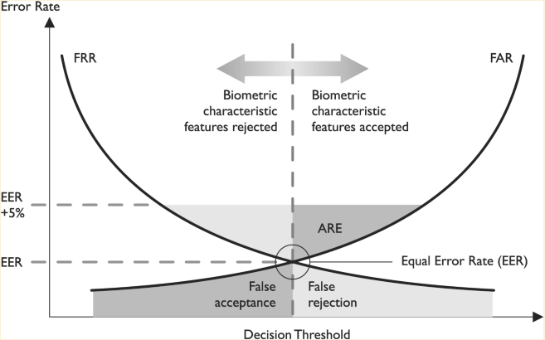
CER

Slide 49
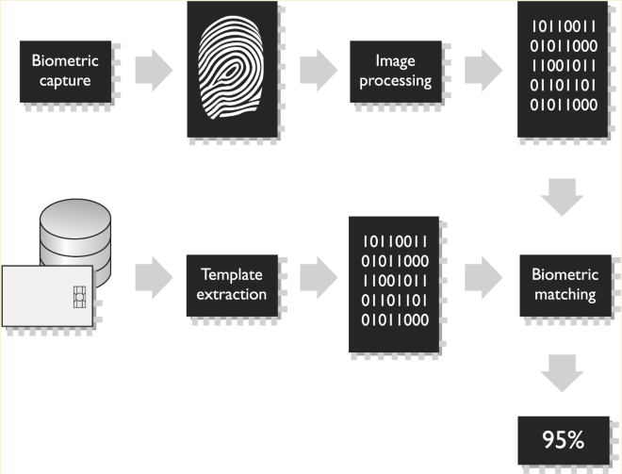
Biometric problems?
Expensive
Unwieldy
Intrusive
Can be slow (should not take more than 5-10 seconds)
Complex (enrollment)
Privacy Issues

Slide 50
Biometric Types Overview
We will talk in more depth of each in the next couple slides
Fingerprint
Hand Geometry
Retina Scan
Iris Scan
Keyboard Dynamics
Keyboard Dynamics
Voice Print
Facial Scan

Slide 51

Finger Print

Slide 52
Fingerprint
Measures ridge endings an bifurcations (changes in the qualitative or topological structure) and other details called “minutiae”
Full fingerprint is stored, the scanners just compute specific features and values and sends those for verification against the real fingerprint.
Notes:
Fingerprint Fingerprints are made up of ridge endings and bifurcations exhibited by friction ridges and other detailed characteristics called minutiae . It is the distinctiveness of these minutiae that gives each individual a unique fingerprint. An individual places his finger on a device that reads the details of the fingerprint and compares this to a reference file. If the two match, the individual’s identity has been verified.
Harris, Shon (2012-11-08). CISSP All-in-One Exam Guide, 6th Edition (Kindle Locations 4228-4231). McGraw-Hill Education. Kindle Edition.

Slide 53
Hand Topography
Peaks and valleys of hand along with overall shape and curvature
This is opposed to size and width of the fingers (hand geometry)
Camera on the side at an angle snaps a pictures
Not unique enough to stand on it’s own, but can be used with hand geometry to add assurance
Notes:
Palm Scan The palm holds a wealth of information and has many aspects that are used to identify an individual. The palm has creases, ridges, and grooves throughout that are unique to a specific person. The palm scan also includes the fingerprints of each finger . An individual places his hand on the biometric device, which scans and captures this information. This information is compared to a reference file, and the identity is either verified or rejected.
Harris, Shon (2012-11-08). CISSP All-in-One Exam Guide, 6th Edition (Kindle Locations 4234-4238). McGraw-Hill Education. Kindle Edition.

Slide 54
Hand Geometry
Measures:
Overall shape of hand
Length and width of fingers
Notes:
Hand Geometry The shape of a person’s hand (the shape, length, and width of the hand and fingers) defines hand geometry. This trait differs significantly between people and is used in some biometric systems to verify identity. A person places her hand on a device that has grooves for each finger. The system compares the geometry of each finger, and the hand as a whole, to the information in a reference file to verify that person’s identity.
Harris, Shon (2012-11-08). CISSP All-in-One Exam Guide, 6th Edition (Kindle Locations 4238-4241). McGraw-Hill Education. Kindle Edition.

Slide 55
Retina Scan
Reads blood vessel patterns on the back of the eye.
Patterns are extremely unique
Retina patters can change
Can possibly be a privacy issue
Place scanner so sun does NOT shine through aperture*
Notes:
Retina Scan A system that reads a person’s retina scans the blood-vessel pattern of the retina on the backside of the eyeball. This pattern has shown to be extremely unique between different people. A camera is used to project a beam inside the eye and capture the pattern and compare it to a reference file recorded previously.
Harris, Shon (2012-11-08). CISSP All-in-One Exam Guide, 6th Edition (Kindle Locations 4241-4244). McGraw-Hill Education. Kindle Edition.

Slide 56
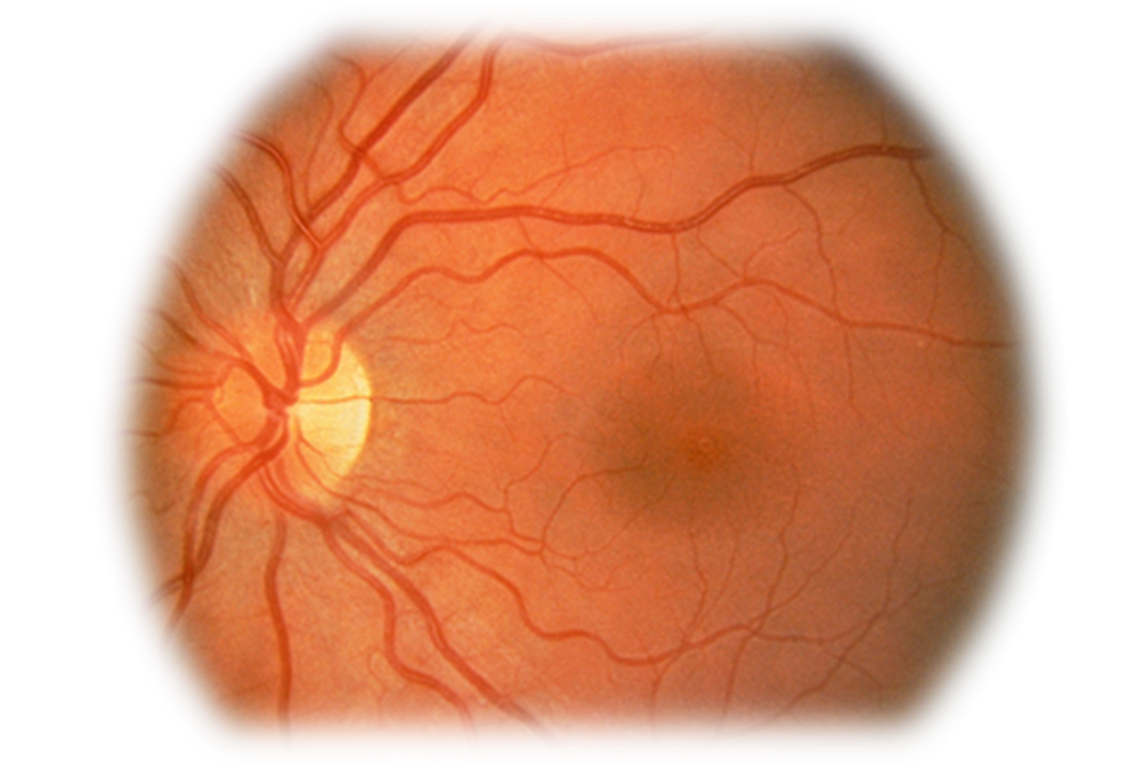
Retina Scan

Slide 57
Iris Scan
Measures
Colors
Rifts
Rings
Furrows (wrinkle, rut or groove)
Has the most assurance of all biometric systems*
IRIS remains constant through adulthood
Place scanner so sun does NOT shine through aperture*
Notes:
Iris Scan The iris is the colored portion of the eye that surrounds the pupil. The iris has unique patterns, rifts, colors, rings, coronas, and furrows. The uniqueness of each of these characteristics within the iris is captured by a camera and compared with the information gathered during the enrollment phase. Of the biometric systems, iris scans are the most accurate . The iris remains constant through adulthood , which reduces the type of errors that can happen during the authentication process. Sampling the iris offers more reference coordinates than any other type of biometric. Mathematically, this means it has a higher accuracy potential than any other type of biometric.
Harris, Shon (2012-11-08). CISSP All-in-One Exam Guide, 6th Edition (Kindle Location 4248). McGraw-Hill Education. Kindle Edition.

Slide 58
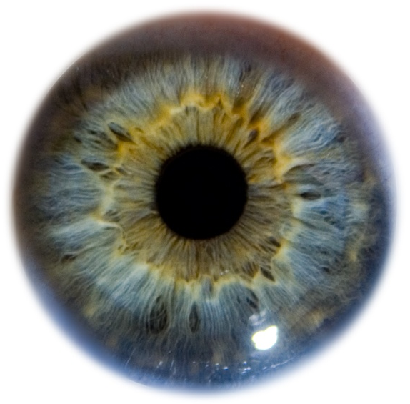
Iris Scan

Slide 59
Signature Dynamics
Work on the fact that most people sign in the same manner, and this is hard to reproduce
Monitor the motions and the pressure while moving (as opposed to a static signature)
Type I error rate is high
Type II error rate is low
Notes:
Signature Dynamics When a person signs a signature, usually they do so in the same manner and speed each time . Signing a signature produces electrical signals that can be captured by a biometric system . The physical motions performed when someone is signing a document create these electrical signals. The signals provide unique characteristics that can be used to distinguish one individual from another. Signature dynamics provides more information than a static signature, so there are more variables to verify when confirming an individual’s identity and more assurance that this person is who he claims to be. Signature dynamics is different from a digitized signature. A digitized signature is just an electronic copy of someone’s signature and is not a biometric system that captures the speed of signing, the way the person holds the pen, and the pressure the signer exerts to generate the signature.
Harris, Shon (2012-11-08). CISSP All-in-One Exam Guide, 6th Edition (Kindle Locations 4251-4257). McGraw-Hill Education. Kindle Edition.

Slide 60
Keyboard dynamics
Measure the speeds and motions as you type, including timed difference between characters typed. For a given phrase
This is more effective than a password
it is hard to repeats someone's typing style, where as it’s easy to get someone's password.
Notes:
Keystroke Dynamics Whereas signature dynamics is a method that captures the electrical signals when a person signs a name, keystroke dynamics captures electrical signals when a person types a certain phrase. As a person types a specified phrase, the biometric system captures the speed and motions of this action. Each individual has a certain style and speed, which translate into unique signals. This type of authentication is more effective than typing in a password, because a password is easily obtainable. It is much harder to repeat a person’s typing style than it is to acquire a password.
Harris, Shon (2012-11-08). CISSP All-in-One Exam Guide, 6th Edition (Kindle Locations 4257-4261). McGraw-Hill Education. Kindle Edition.

Slide 61
Voice Print
Measures speech patterns, inflection and intonation (i.e.. pitch and tone)
For enrollment, you say several different phrases.
For authentication words are jumbled.
Notes:
Voice Print People’s speech sounds and patterns have many subtle distinguishing differences. A biometric system that is programmed to capture a voice print and compare it to the information held in a reference file can differentiate one individual from another. During the enrollment process, an individual is asked to say several different words. Later, when this individual needs to be authenticated, the biometric system jumbles these words and presents them to the individual. The individual then repeats the sequence of words given. This technique is used so others cannot attempt to record the session and play it back in hopes of obtaining unauthorized access.
Harris, Shon (2012-11-08). CISSP All-in-One Exam Guide, 6th Edition (Kindle Locations 4262-4266). McGraw-Hill Education. Kindle Edition.

Slide 62
Facial Scan
Geometric measurements of
Bone structure
Nose ridges
Eye width
Chin shape
Forehead size
Notes:
Facial Scan A system that scans a person’s face takes many attributes and characteristics into account. People have different bone structures, nose ridges, eye widths, forehead sizes, and chin shapes . These are all captured during a facial scan and compared to an earlier captured scan held within a reference record. If the information is a match, the person is positively identified.
Harris, Shon (2012-11-08). CISSP All-in-One Exam Guide, 6th Edition (Kindle Locations 4267-4269). McGraw-Hill Education. Kindle Edition.

Slide 63
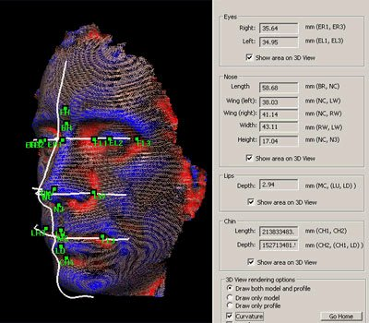
Facial Scan

Slide 64
Biometrics wrap up
We covered a bunch of different biometrics
Understand some are behavioral* based
Voice print
Keyboard dynamics
Can change over time
Some are physically based
Fingerprint
Iris scan

Slide 65
Biometrics wrap Up
Fingerprints are probably the most commonly used and cheapest*
Iris scanning provides the most “assurance”*
Some methods are intrusive*
Biometrics do cause privacy issues*

Slide 66
Biometrics Wrap up
Understand Type I and Type II errors
Be able to define CER, is a lower CER value better or worse?

Slide 67
Passwords

Slide 68
Passwords
Password – A protected string of characters that one uses to authenticate themselves.
Password authentication is:
Something you know

Slide 69
Passwords
Password traits
Simplest form of authentication*
Cheapest form of authentication*
Oldest form of authentication
Most commonly used form of authentication*
Weakest form of authentication*

Slide 70
Problems with Passwords
People write down passwords
People use weak passwords
People re-use passwords
If you make passwords to hard to remember then people write them down
If you make them too easy then they are easily cracked

Slide 71
Password Management
Proper Password Management, including password policies can help mitigate some of the problems with passwords.
First choose a strong password!
Minimum password lengths - 8
Case changes, number and special characters
1 or more A-Z
1 or more a-z
1 or more 0-9
1 or more special character
No personal information (usernames, real name, children's names, birthdates)

Slide 72
Password Management
Use a password checker before accepting a new password
The OS should enforce password requirements
Aging –when a password expires
Minimum password age: days to weeks
Maximum password age : 60-90 days
Reuse of old passwords (password history)
Minimum number of characters
Limit login attempts – disable logins after a certain number of failed attempts
(more)

Slide 73
Password Management
System should NOT store passwords in plaintext, hash them instead.
Use passwords salts
random values added to the encryption/hash process to make it harder to brute force (one password may hash/encrypt to multiple different results)

Slide 74
Passphrases
I like to use a “passphrase” to generate a password
I Like Iced Tea and Cranberry with Lemon
I L I T A C W L
1 L 1 t @ c w l

Slide 75
Attacks on Password
Sniffing (Electronic Monitoring)
Dictionary Attack
Brute force attacks
Social Engineering
Rainbow tables
Notes:
If an attacker is after a password, she can try a few different techniques: • Electronic monitoring Listening to network traffic to capture information, especially when a user is sending her password to an authentication server. The password can be copied and reused by the attacker at another time, which is called a replay attack. • Access the password file Usually done on the authentication server. The password file contains many users’ passwords and, if compromised, can be the source of a lot of damage. This file should be protected with access control mechanisms and encryption. • Brute force attacks Performed with tools that cycle through many possible character, number, and symbol combinations to uncover a password. • Dictionary attacks Files of thousands of words are compared to the user’s password until a match is found. • Social engineering An attacker falsely convinces an individual that she has the necessary authorization to access specific resources. • Rainbow table An attacker uses a table that contains all possible passwords already in a hash format.
Harris, Shon (2012-11-08). CISSP All-in-One Exam Guide, 6th Edition (Kindle Locations 4299-4308). McGraw-Hill Education. Kindle Edition.

Slide 76
Virtual Password
Simply a phrase, application will probably make a “virtual password” from the passphrase (etc a hash)
Generally more secure than a password
Longer
Yet easier to remember

Slide 77
Cognitive passwords
Facts that only a user should know.
Can be used by helpdesk authenticate a user without revealing the password.
Often used for password reset challenges

Slide 78
Cognitive Passwords
“As detailed in the postings, the Palin hack didn’t require any real skill. Instead, the hacker simply reset Palin’s password using her birth date, ZIP code and information about where she met her spouse — the security question on her Yahoo account, which was answered (Wasilla High) by a simple Google search.”
http://www.wired.com/threatlevel/2008/09/palin-e-mail-ha/

Slide 79
One Time Password
Password that is used only once then no longer valid
Used in high security environments
VERY secure
Not vulnerable to electronic eavesdropping, but vulnerable to loss of token.
Require a token device to generate passwords. (RSA SecureID key is an example)

Slide 80
One Time Password Token Type
One time passwords are one of two types that we are about to discuss.
Synchronous
Asynchronous

Slide 81
Synchronous One Time Password
Synchronous – uses time to synchronize between token and authentication server
Clocks must be synchronized!
Can also use counter-sync which a button is pushed that increments values on the token and the server

Slide 82
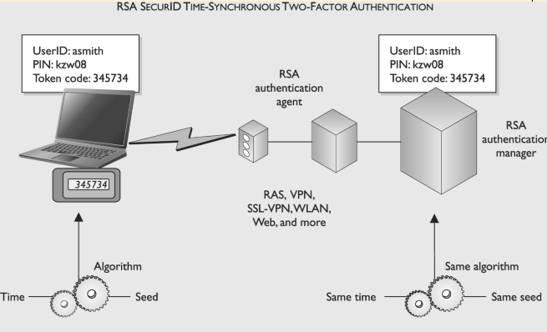
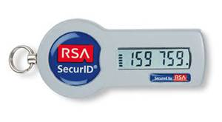
Synchronous One Time Password

Slide 83
Asynchronous OTP
Asynchronous
Challenge response
Auth sends a challenge (a random value called a nonce)*
User enters nonce into token, along with PIN
Token encrypts nonce and returns value
Users inputs value into workstation
If server can decrypt then you are good.

Slide 84
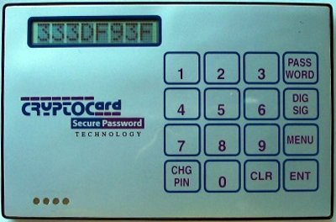
Challenge OTP

Slide 85
Other Types of Authentication
Other types of Authentication that we are about to discuss are
Digital Signatures
Memory Cards
Smart Cards

Slide 86
Digital Signatures
Digital Signature (talk about in more depth in chapter 8).
Take a hash value of a message, encrypt hash with your private key
Anyone with your public key can decrypt and verify message is from you.

Slide 87
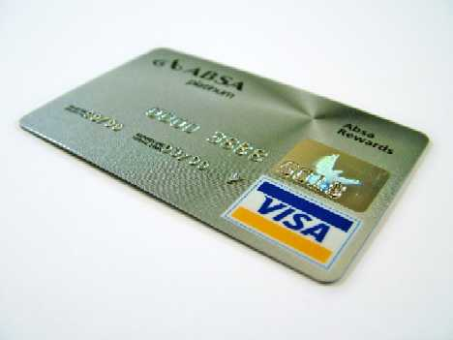
Memory Cards – e.g. strip only w/o chip & pin

Slide 88
Memory Cards
NOT a smart card
Holds information, does NOT process
A memory card holds authentication info, usually you’ll want to pair this with a PIN… WHY?
A credit card or ATM card is a type of memory card, so is a key/swipe card
Usually insecure, easily copied.*

Slide 89
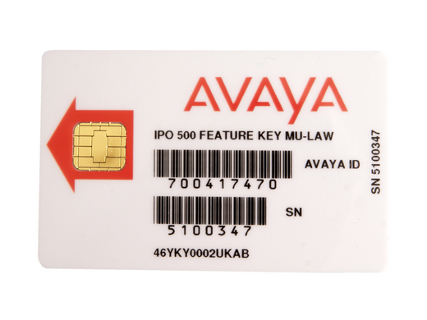
Smart Card

Slide 90
Smart Card
Much more secure than memory cards
Can actually process information
Includes a microprocessor and ICs
Can provide two factor authentication, as you the card can store authentication protected by a pin. (so you need the card, and you need to know something)
Two types
Contact
contactless

Slide 91
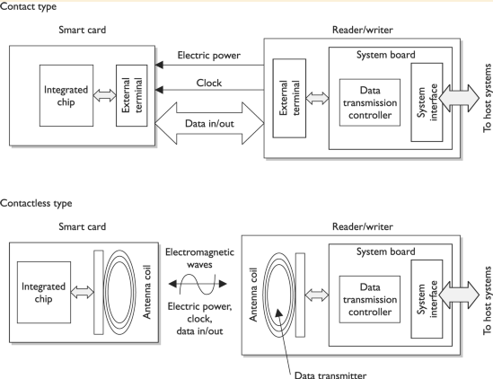

Slide 92
Smart Card Attacks
There are attacks against smart cards
1. Fault generation – manipulate environmental controls and measure errors in order to reverse engineer logic etc.
(more)
Notes:
Over the years, people have become very inventive in the development of various ways to attack smart cards. For example, individuals have introduced computational errors into smart cards with the goal of uncovering the encryption keys used and stored on the cards. These “errors” are introduced by manipulating some environmental component of the card (changing input voltage, clock rate, temperature fluctuations). The attacker reviews the result of an encryption function after introducing an error to the card, and also reviews the correct result, which the card performs when no errors are introduced. Analysis of these different results may allow an attacker to reverse-engineer the encryption process, with the hope of uncovering the encryption key. This type of attack is referred to as fault generation.
Harris, Shon (2012-11-08). CISSP All-in-One Exam Guide, 6th Edition (Kindle Locations 4472-4477). McGraw-Hill Education. Kindle Edition.

Slide 93
Smart Card Attacks
2. Side Channel Attacks – Measure the cards while they work
Differential power analysis – measure power emissions
Electromagnetic analysis – example frequencies emitted
(more)
Notes:
Side-channel attacks are nonintrusive and are used to uncover sensitive information about how a component works, without trying to compromise any type of flaw or weakness. As an analogy, suppose you want to figure out what your boss does each day at lunch time but you feel too uncomfortable to ask her. So you follow her, and you see she enters a building holding a small black bag and exits exactly 45 minutes later with the same bag and her hair not looking as great as when she went in. You keep doing this day after day and come to the conclusion that she must be working out. Now you could have simply read the sign on the building that said “Gym,” but we will give you the benefit of the doubt here and just not call you for any further private investigator work.
Harris, Shon (2012-11-08). CISSP All-in-One Exam Guide, 6th Edition (Kindle Locations 4477-4483). McGraw-Hill Education. Kindle Edition.

Slide 94
Smart Card Attacks
3. Micro probing* - using needles to vibrations to remove the outer protection on the cards circuits. Then tap into ROMS if possible or “die” ROMS to read data.
Notes:
Microprobing uses needleless and ultrasonic vibration to remove the outer protective material on the card’s circuits. Once this is completed, data can be accessed and manipulated by directly tapping into the card’s ROM chips.
Harris, Shon (2012-11-08). CISSP All-in-One Exam Guide, 6th Edition (Kindle Locations 4495-4497). McGraw-Hill Education. Kindle Edition.

Slide 95
Authorization

Slide 96
Authorization
Now that I proved I am who I say I am, what can I do?
Both OSes and Applications can provide this functionality.
Authorization can be provided based on user, groups, roles, rules, physical location, time of day (temporal isolation)* or transaction type (example a teller may be able to withdrawal small amounts, but require manager for large withdrawals)

Slide 97
Authorization principals
Default NO access (implicit deny)* - Unless a subject is explicitly given access to an object, then they are implicitly denied access.
very important principal you must understand this.
Roles
Groups
Physical or logical location
Time of day
Transaction-type restrictions
Need to know & least privilege

Slide 98
Authorization Creep*
As a subject stays in an environment over time, their permissions accumulate even after they are no longer needed.
Auditing authorization can help mitigate this. SOX requires yearly auditing.

Slide 99
Single Sign On
As environments get larger and more complex it becomes harder and harder to manage users accounts securely.
Multiple users to create/disable
Passwords to remember, leads to passwords security issues
Reduces user frustration as well as IT frustration!
Wastes your IT budget trying to manage disparate accounts.

Slide 100
Single Sign On
Single sign on systems try to mitigate this problem. Some SSO systems are.
Sun NIS/YP
Kerberos
LDAP
Microsoft Active Directory*

Slide 101
SSO downsides
Centralized point of failure*
Can cause bottlenecks*
All vendors have to play nicely (good luck)
Often very difficult to accomplish*
One ring to bind them all!...If you can access once, you can access ALL!

Slide 102
SSO technologies
Sun NIS/YP
Kerberos
SESAME
LDAP
Microsoft Active Directory*

Slide 103
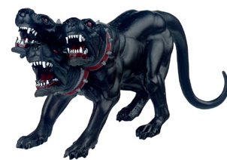
Kerberos

Slide 104
Kerberos
A network authentication protocol designed from MITs project Athena. Kerberos tries to ensure authentication security in an insecure environment
Used in Windows2000+ and some Unix
Allows for single sign on
Never transfers passwords
Uses PRIVATE key encryption to verify Identification
Avoids replay attacks

Slide 105
Kerberos Components
Principals – users or network services
KDC – Key Distribution Center, stores secret keys (passwords) for principals
Tickets
Ticket Granting Ticket (TGT) gets you more tickets
Service Tickets – access to specific network services (ex. File sharing)
Realms – a grouping of principals that a KDC provides service for, looks like a domain name
Example: somedepartment.mycompany.com

Slide 106
Kerberos Concerns
Computers must have clocks synchronized within 5 minutes of each other
Tickets are stored on the workstation. If the workstation is compromised your identity can be forged.
If your KDC is hacked, security is lost
A single KDC is a single point of failure and performance bottleneck*
Still vulnerable to password guessing attacks

Slide 107
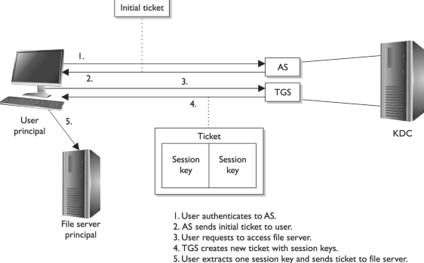
How Kerberos Works
Notes:
The Kerberos Authentication Process
The user and the KDC share a secret key, while the service and the KDC share a different secret key. The user and the requested service do not share a symmetric key in the beginning. The user trusts the KDC because they share a secret key. They can encrypt and decrypt data they pass between each other, and thus have a protected communication path. Once the user authenticates to the service, they, too, will share a symmetric key (session key) that is used for authentication purposes. Here are the exact steps: 1. Emily comes in to work and enters her username and password into her workstation at 8: 00 A.M. The Kerberos software on Emily’s computer sends the username to the authentication service (AS) on the KDC, which in turn sends Emily a ticket granting ticket (TGT) that is encrypted with Emily’s password (secret key). 2. If Emily has entered her correct password, then this TGT is decrypted and Emily gains access to her local workstation desktop. 3. When Emily needs to send a print job to the print server, her system sends the TGT to the ticket granting service (TGS), which runs on the KDC, and a request to access the print server. (The TGT allows Emily to prove she has been authenticated and allows her to request access to the print server.) 4. The TGS creates and sends a second ticket to Emily, which she will use to authenticate to the print server. This second ticket contains two instances of the same session key, one encrypted with Emily’s secret key and the other encrypted with the print server’s secret key. The second ticket also contains an authenticator, which contains identification information on Emily, her system’s IP address, sequence number, and a timestamp. 5. Emily’s system receives the second ticket, decrypts and extracts the embedded session key, adds a second authenticator set of identification information to the ticket, and sends the ticket on to the print server. 6. The print server receives the ticket, decrypts and extracts the session key, and decrypts and extracts the two authenticators in the ticket. If the print server can decrypt and extract the session key, it knows the KDC created the ticket, because only the KDC has the secret key used to encrypt the session key. If the authenticator information that the KDC and the user put into the ticket matches, then the print server knows it received the ticket from the correct principal. 7. Once this is completed, it means Emily has been properly authenticated to the print server and the server prints her document. This is an extremely simplistic overview of what is going on in any Kerberos exchange , but it gives you an idea of the dance taking place behind the scenes whenever you interact with any network service in an environment that uses Kerberos. Figure 3-12 provides a simplistic view of this process.
Harris, Shon (2012-11-08). CISSP All-in-One Exam Guide, 6th Edition (Kindle Locations 4665-4688). McGraw-Hill Education. Kindle Edition.

Slide 108
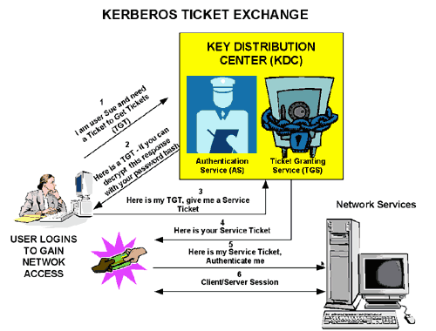
How Kerberos Works
https://msdn.microsoft.com/en-us/library/bb742516.aspx
Notes:
The steps in the process are:
A principal name and key are specified to the client.
The client sends the principal name and a request for a TGT to the KDC.
The KDC generates a session key and a TGT that contains a copy of the session key, and uses the Ticket Granting Service (TGS) key to encrypt the TGT. It then uses the principal's key to encrypt both the already encrypted TGT and another copy of the session key.
The KDC sends the encrypted combination of the session key and the encrypted TGT to the client.
The client uses the principal's key to extract the session key and the encrypted TGT.
When the client want to use a service, usually to obtain access to a local or remote host system, it uses the session key to encrypt a copy of the encrypted TGT, the client’s IP address, a time stamp, and a service ticket request, and it sends this item to the KDC.
The KDC uses its copies of the session key and the TGS key to extract the TGT, IP address, and time stamp, which allow it to validate the client. Provided that both the client and its service request are valid, the KDC generates a service session key and a service ticket that contains the client’s IP address, a time stamp, and a copy of the service session key, and it uses the service key to encrypt the service ticket. It then uses the session key to encrypt both the service ticket and another copy of the service session key.
The service key is usually the host principal's key for the system on which the service provider runs.
The KDC sends the encrypted combination of the service session key and the encrypted service ticket to the client.
The client uses its copy of the session key to extract the encrypted service ticket and the service session key.
The client sends the encrypted service ticket to the service provider together with the principal name and a time stamp encrypted with the service session key.
The service provider uses the service key to extract the data in the service session ticket, including the service session key.
The service provider enables the service for the client, which is usually to grant access to its host system.
If the client and service provider are hosted on different systems, they can each use their own copy of the service session key to secure network communication for the service session.
Note the following points about the authentication handshake:
Steps 1 through 3 correspond to using the kinit command to obtain and cache a TGT.
Steps 4 through 7 correspond to using a TGT to gain access to a Kerberos-aware service.
Authentication relies on pre-shared keys.
Keys are never sent in the clear over any communications channel between the client, the KDC, and the service provider.
At the start of the authentication process, the client and the KDC share the principal's key, and the KDC and the service provider share the service key. Neither the principal nor the service provider know the TGS key.
At the end of the process, both the client and the service provider share a service session key that they can use to secure the service session. The client does not know the service key and the service provider does not know the principal's key.
The client can use the TGT to request access to other service providers for the lifetime of the ticket, which is usually one day. The session manager renews the TGT if it expires while the session is active.

Slide 109
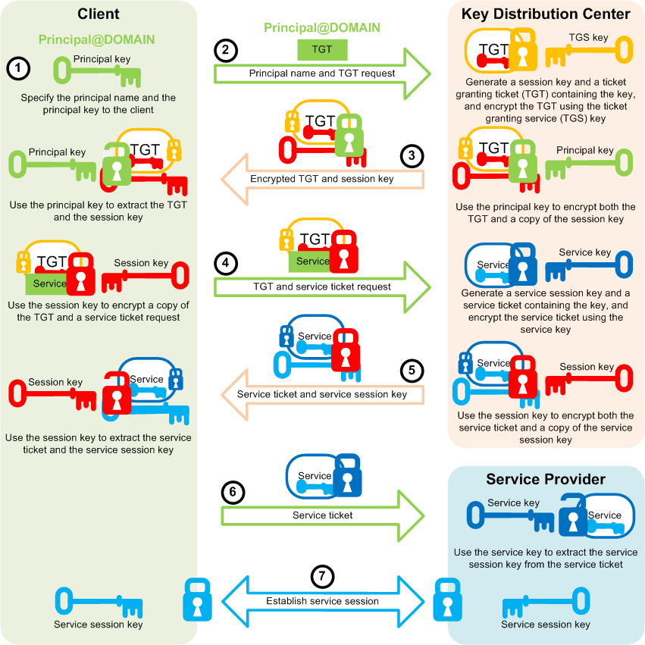
How Kerberos Works
https://docs.oracle.com/cd/E37670_01/E41138/html/ol_kerberosauth_sec.html
Notes:
The steps in the process are:
A principal name and key are specified to the client.
The client sends the principal name and a request for a TGT to the KDC.
The KDC generates a session key and a TGT that contains a copy of the session key, and uses the Ticket Granting Service (TGS) key to encrypt the TGT. It then uses the principal's key to encrypt both the already encrypted TGT and another copy of the session key.
The KDC sends the encrypted combination of the session key and the encrypted TGT to the client.
The client uses the principal's key to extract the session key and the encrypted TGT.
When the client want to use a service, usually to obtain access to a local or remote host system, it uses the session key to encrypt a copy of the encrypted TGT, the client’s IP address, a time stamp, and a service ticket request, and it sends this item to the KDC.
The KDC uses its copies of the session key and the TGS key to extract the TGT, IP address, and time stamp, which allow it to validate the client. Provided that both the client and its service request are valid, the KDC generates a service session key and a service ticket that contains the client’s IP address, a time stamp, and a copy of the service session key, and it uses the service key to encrypt the service ticket. It then uses the session key to encrypt both the service ticket and another copy of the service session key.
The service key is usually the host principal's key for the system on which the service provider runs.
The KDC sends the encrypted combination of the service session key and the encrypted service ticket to the client.
The client uses its copy of the session key to extract the encrypted service ticket and the service session key.
The client sends the encrypted service ticket to the service provider together with the principal name and a time stamp encrypted with the service session key.
The service provider uses the service key to extract the data in the service session ticket, including the service session key.
The service provider enables the service for the client, which is usually to grant access to its host system.
If the client and service provider are hosted on different systems, they can each use their own copy of the service session key to secure network communication for the service session.
Note the following points about the authentication handshake:
Steps 1 through 3 correspond to using the kinit command to obtain and cache a TGT.
Steps 4 through 7 correspond to using a TGT to gain access to a Kerberos-aware service.
Authentication relies on pre-shared keys.
Keys are never sent in the clear over any communications channel between the client, the KDC, and the service provider.
At the start of the authentication process, the client and the KDC share the principal's key, and the KDC and the service provider share the service key. Neither the principal nor the service provider know the TGS key.
At the end of the process, both the client and the service provider share a service session key that they can use to secure the service session. The client does not know the service key and the service provider does not know the principal's key.
The client can use the TGT to request access to other service providers for the lifetime of the ticket, which is usually one day. The session manager renews the TGT if it expires while the session is active.

Slide 110
Access Control Models

Slide 111
Access Control Models
A framework that dictates how subjects access objects.
Uses access control technologies and security mechanisms to enforce the rules
Business goals and culture of the organization will prescribe which model is used
Every OS has a security kernel/reference monitor (talk about in another chapter) that enforces the access control model.

Slide 112
Access Control Models
The models we are about to discuss are
DAC
MAC
Roles based

Slide 113
DAC
Discretionary Access Control*
Owner or creator of resource specifies which subjects have which access to a resource. Based on the Discretion of the data owner*
Common example is an ACL (what is an ACL?)
Commonly implemented in commercial products (Windows, Linux, MacOS)
This can make a user’s ability to access information dynamic versus the more static role of mandatory access control (MAC).
Notes:
If a user creates a file, he is the owner of that file. An identifier for this user is placed in the file header and/ or in an access control matrix within the operating system. Ownership might also be granted to a specific individual . For example, a manager for a certain department might be made the owner of the files and resources within her department. A system that uses discretionary access control (DAC) enables the owner of the resource to specify which subjects can access specific resources. This model is called discretionary because the control of access is based on the discretion of the owner. Many times department managers, or business unit managers, are the owners of the data within their specific department. Being the owner, they can specify who should have access and who should not.
In a DAC model, access is restricted based on the authorization granted to the users. This means users are allowed to specify what type of access can occur to the objects they own. If an organization is using a DAC model, the network administrator can allow resource owners to control who has access to their files. The most common implementation of DAC is through ACLs, which are dictated and set by the owners and enforced by the operating system. This can make a user’s ability to access information dynamic versus the more static role of mandatory access control (MAC).
Harris, Shon (2012-11-08). CISSP All-in-One Exam Guide, 6th Edition (Kindle Locations 4829-4839). McGraw-Hill Education. Kindle Edition.

Slide 114
Malware and DAC
While DAC systems provide a lot of flexibility to the user and less administration for IT, it is also the Achilles heel of operating systems.
Malware can install itself and work under the security context of the user.
For example, if a user opens an attachment that is infected with a virus, the code can install itself in the background without the user being aware of this activity.
This code basically inherits all the rights and permissions that the user has and can carry out all the activities the user can on the system.

Slide 115
MAC
Mandatory Access Control*
The MAC model is much more structured and strict than the DAC model and is based on a security label system. *
The clearance and classification data are stored in the security labels, which are bound to the specific subjects and objects .
Users are given a security clearance (secret, top secret, confidential, and so on), and data is classified in the same way.
Notes:
This system holds sensitive, super-duper, secret stuff. In a mandatory access control (MAC) model, users do not have the discretion of determining who can access objects as in a DAC model. An operating system that is based upon a MAC model greatly reduces the amount of rights, permissions, and functionality a user has for security purposes. In most systems based upon the MAC model, a user cannot install software , change file permissions, add new users, etc. The system can be used by the user for very focused and specific purposes, and that is it. These systems are usually very specialized and are in place to protected highly classified data. Most people have never interacted with a MAC-based system because they are used by government-oriented agencies that maintain top secret information.
The MAC model is much more structured and strict than the DAC model and is based on a security label system. Users are given a security clearance (secret, top secret, confidential, and so on), and data is classified in the same way. The clearance and classification data are stored in the security labels, which are bound to the specific subjects and objects . When the system makes a decision about fulfilling a request to access an object, it is based on the clearance of the subject, the classification of the object, and the security policy of the system. The rules for how subjects access objects are made by the organization’s security policy, configured by the security administrator, enforced by the operating system, and supported by security technologies.
Harris, Shon (2012-11-08). CISSP All-in-One Exam Guide, 6th Edition (Kindle Locations 4866-4877). McGraw-Hill Education. Kindle Edition.

Slide 116
MAC
MAC is used where classification and confidentiality is of utmost importance… military.
Generally you have to buy a specific MAC system, DAC systems don’t do MAC
SELinux
Trusted Solaris
Notes:
The classifications follow a hierarchical structure, with one level being more trusted than another. However, the categories do not follow a hierarchical scheme, because they represent compartments of information within a system. The categories can correspond to departments (UN, Information Warfare, Treasury), projects (CRM, AirportSecurity , 2011Budget), or management levels. In a military environment, the classifications could be top secret, secret, confidential, and unclassified. Each classification is more trusted than the one below it. A commercial organization might use confidential, proprietary , corporate, and sensitive. The definition of the classification is up to the organization and should make sense for the environment in which it is used.
Harris, Shon (2012-11-08). CISSP All-in-One Exam Guide, 6th Edition (Kindle Locations 4905-4910). McGraw-Hill Education. Kindle Edition.

Slide 117
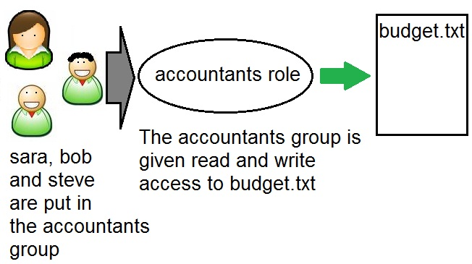
Role Based Access Control

Slide 118
Role Based Access Control
Also called non-discretionary.
Uses a set of controls to determine how subjects and objects interact.
Don’t give rights to users directly.
Instead create “roles” which are given rights.
Assign users to roles rather than providing users directly with privileges.
Advantages:
This scales better than DAC methods
Fights “authorization creep”*

Slide 119
Role based Access control
When to use*
If you need centralized access*
If you DON’T need MAC ;)
If you have high turnover*

Slide 120
DAC vs. MAC vs. RBAC
The main characteristics of the three different access control models are important to understand.
DAC: Data owners decide who has access to resources, and ACLs are used to enforce these access decisions.
MAC: Operating systems enforce the system’s security policy through the use of security labels.
RBAC: Access decisions are based on each subject’s role and/ or functional position.
Notes:
RBAC, MAC, and DAC A lot of confusion exists regarding whether RBAC is a type of DAC model or a type of MAC model. Different sources claim different things, but in fact it is a model in its own right. In the 1960s and 1970s , the U.S. military and NSA did a lot of research on the MAC model . DAC, which also sprang to life in the ’60s and ’70s, has its roots in the academic and commercial research laboratories. The RBAC model, which started gaining popularity in the 1990s, can be used in combination with MAC and DAC systems. For the most up-to-date information on the RBAC model, go to http:// csrc.nist.gov/ rbac, which has documents that describe an RBAC standard and independent model, with the goal of clearing up this continual confusion. In reality, operating systems can be created to use one, two, or all three of these models in some form, but just because they can be used together does not mean that they are not their own individual models with their own strict access control rules.
Harris, Shon (2012-11-08). CISSP All-in-One Exam Guide, 6th Edition (Kindle Locations 4988-4992). McGraw-Hill Education. Kindle Edition.

Slide 121


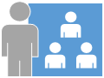

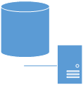
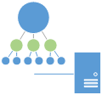

DAC vs. MAC vs. RBAC
DAC
MAC
SUBJECTS
Authorizations based on (user or group) permissions. Zero knowledge of object sensitivity.
Authorizations based on (user or group) permissions and object labels.
RBAC
Authorizations based on group permissions. Users here are part of a group.
Reference Monitor
Label
OBJECTS
Notes:
RBAC, MAC, and DAC A lot of confusion exists regarding whether RBAC is a type of DAC model or a type of MAC model. Different sources claim different things, but in fact it is a model in its own right. In the 1960s and 1970s , the U.S. military and NSA did a lot of research on the MAC model . DAC, which also sprang to life in the ’60s and ’70s, has its roots in the academic and commercial research laboratories. The RBAC model, which started gaining popularity in the 1990s, can be used in combination with MAC and DAC systems. For the most up-to-date information on the RBAC model, go to http:// csrc.nist.gov/ rbac, which has documents that describe an RBAC standard and independent model, with the goal of clearing up this continual confusion. In reality, operating systems can be created to use one, two, or all three of these models in some form, but just because they can be used together does not mean that they are not their own individual models with their own strict access control rules.
Harris, Shon (2012-11-08). CISSP All-in-One Exam Guide, 6th Edition (Kindle Locations 4988-4992). McGraw-Hill Education. Kindle Edition.

Slide 122
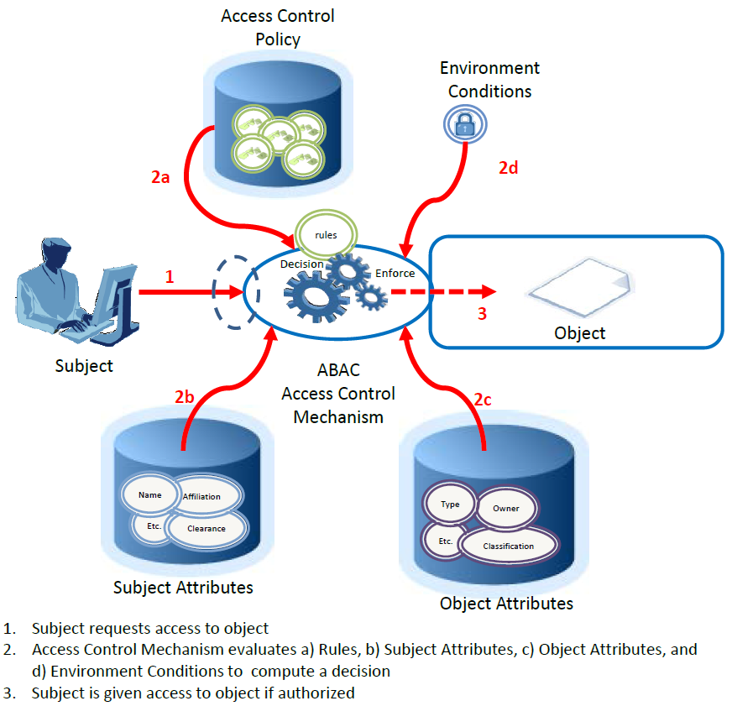
Attribute-Based Access Control
http://nvlpubs.nist.gov/nistpubs/specialpublications/NIST.sp.800-162.pdf
Notes:
ACLs and RBAC are in some ways special cases of ABAC in terms of the attributes used. ACLs work on the attribute of “identity”. RBAC works on the attribute of “role”. The key difference with ABAC is the concept of policies that express a complex Boolean rule set that can evaluate many different attributes. While it is possible to achieve ABAC objectives using ACLs or RBAC, demonstrating AC requirements compliance is difficult and costly due to the level of abstraction required between the AC requirements and the ACL or RBAC model. Another problem with ACL or RBAC models is that if the AC requirement is changed, it may be difficult to identify all the places where the ACL or RBAC implementation needs to be updated.
One example of an access control framework that is consistent with ABAC is the Extensible Access Control Markup Language (XACML) [XACML]. The XACML model employs elements such as rules, policies, rule- and policy-combining algorithms, attributes (subject, (resource) object, action and environment conditions), obligations, and advice. Its reference architecture includes functions such as Policy Decision Points (PDPs), Policy Enforcement Points (PEPs), Policy Administration Points (PAPs), and Policy Information Points (PIPs) to control access. Another example is the Next Generation Access Control standard [ANSI499].
In general, ABAC avoids the need for capabilities (operation/object pairs) to be directly assigned to subject requesters or to their roles or groups before the request is made. Instead, when a subject requests access, the ABAC engine can make an access control decision based on the assigned attributes of the requester, the assigned attributes of the object, environment conditions, and a set of policies that are specified in terms of those attributes and conditions. Under this arrangement policies can be created and managed without direct reference to potentially numerous users and objects, and users and objects can be provisioned without reference to policy.

Slide 123
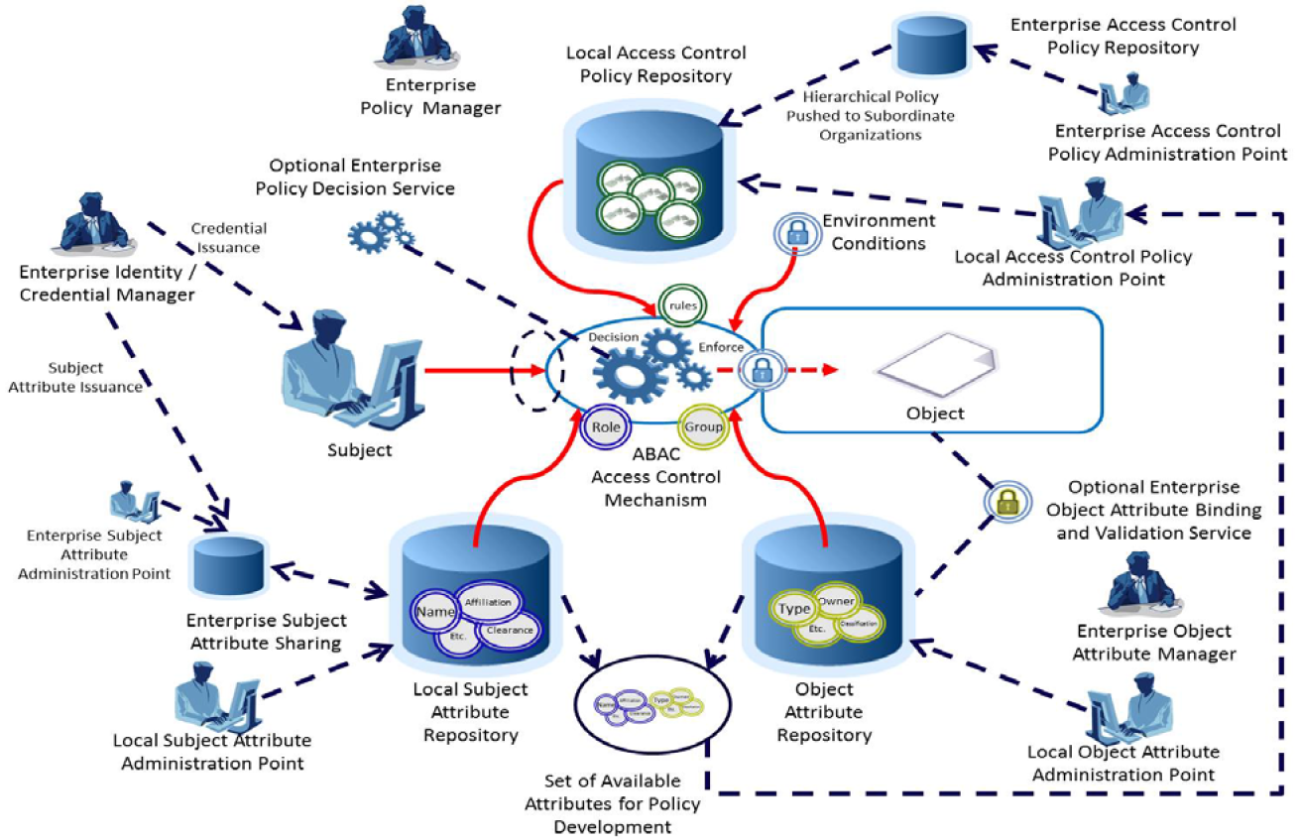
Enterprise ABAC Scenario Example
http://nvlpubs.nist.gov/nistpubs/specialpublications/NIST.sp.800-162.pdf

Slide 124


DAC vs. MAC vs. ABAC
DAC
MAC
ABAC
Discretionary Access Control
Mandatory Access Control
Attribute-Based Access Control
SUBJECTS
ATTRIBUTES
ATTRIBUTES
ATTRIBUTES
REQUESTING HUMAN, USER, OR NON-PERSON-ENTITY (NPE)
OBJECTS
ATTRIBUTES
ATTRIBUTES
RESOURCE OR ENTITY TO BE PROTECTED FROM ACCESS
EVIRONMENT
ATTRIBUTES
DYNAMIC FACTORS, INDEPENDENT OF SUBJECT AND OBJECT
?
Y
Reference Monitor
POLICY, RULES, AND RELATIONSHIPS
WHO
N
WHAT
END
WHO, WHAT, WHEN, WHERE, WHY, HOW, TO WHAT EXTENT

Slide 125
10 Min break!!

Slide 126
Access Control Techniques and Technologies

Slide 127
Access Control technologies that support access control models
We will talk more in depth of each in the next few slides.
Rule-based Access Control
Constrained User Interfaces
Access Control Matrix
Access Control Lists
Content-Dependant Access Control
Context-Dependant Access Control

Slide 128
Rule Based Access Control
Uses specific rules that indicate what can and cannot transpire between subject and object.
“if x then y” logic
Before a subject can access and object it must meet a set of predefined rules.
ex. If a user has proper clearance, and it’s between 9AM -5PM then allow access
However it does NOT have to deal specifically with identity/authorization
Ex. May only accept email attachments 5M or less
Notes:
Rule-based access control uses specific rules that indicate what can and cannot happen between a subject and an object. It is based on the simple concept of “if X then Y” programming rules, which can be used to provide finer -grained access control to resources. Before a subject can access an object in a certain circumstance, it must meet a set of predefined rules. This can be simple and straightforward, as in, “If the user’s ID matches the unique user ID value in the provided digital certificate, then the user can gain access.” Or there could be a set of complex rules that must be met before a subject can access an object. For example, “If the user is accessing the system between Monday and Friday and between 8 A.M. and 5 P.M., and if the user’s security clearance equals or dominates the object’s classification, and if the user has the necessary need to know, then the user can access the object.”
Rule-based access control is not necessarily identity-based. The DAC model is identity-based. For example, an identity-based control would stipulate that Tom Jones can read File1 and modify File2. So when Tom attempts to access one of these files, the operating system will check his identity and compare it to the values within an ACL to see if Tom can carry out the operations he is attempting. In contrast, here is a rule-based example: A company may have a policy that dictates that e-mail attachments can only be 5MB or smaller. This rule affects all users. If rule-based was identity-based, it would mean that Sue can accept attachments of 10MB and smaller, Bob can accept attachments 2MB and smaller, and Don can only accept attachments 1MB and smaller. This would be a mess and too confusing. Rule-based access controls simplify this by setting a rule that will affect all users across the board— no matter what their identity is.
Rule-based access allows a developer to define specific and detailed situations in which a subject can or cannot access an object, and what that subject can do once access is granted. Traditionally, rule-based access control has been used in MAC systems as an enforcement mechanism of the complex rules of access that MAC systems provide. Today, rule-based access is used in other types of systems and applications as well. Content filtering uses If-Then programming languages, which is a way to compare data or an activity to a long list of rules. For example, “If an e-mail message contains the word ‘Viagra,’ then disregard. If an e-mail message contains the words ‘sex’ and ‘free,’ then disregard,” and so on.
Harris, Shon (2012-11-08). CISSP All-in-One Exam Guide, 6th Edition (Kindle Locations 5002-5020). McGraw-Hill Education. Kindle Edition.

Slide 129
Rules Based Access Control
Is considered a “compulsory control” because the rules are strictly enforced and not modifiable by users.
Routers and firewalls use Rule Based access control*

Slide 130
Constrained User Interfaces
Restrict user access by not allowing them see certain data or have certain functionality
Three major types of restricted interfaces exist: menus and shells, database views, and physically constrained interfaces.
Restricted shell – like a real shell but only with certain commands.
Database Views – only allow access to certain data (canned interfaces)
Physically constrained interface – show only certain keys on a keypad/touch screen. – like an ATM. (a modern type of menu) Difference is you are physically constrained from accessing them.

Slide 131
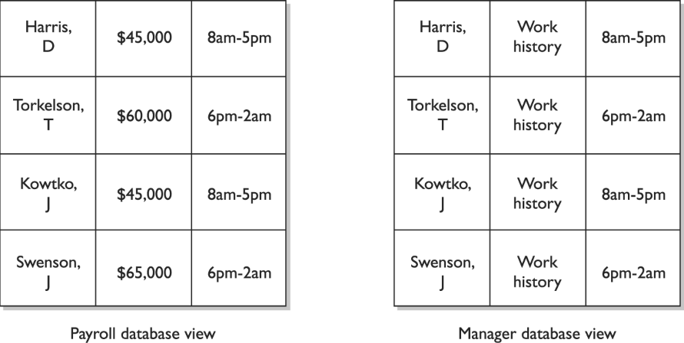
Constrained View

Slide 132
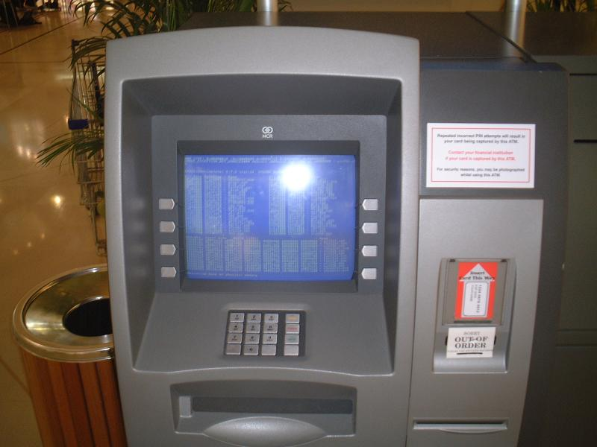
Physically Constrained UI

Slide 133
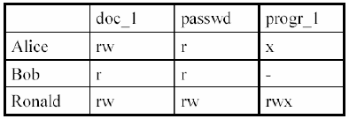
Access Control Matrix*
Table of subjects and objects indicating what actions individuals subjects can take on individual objects*

Slide 134
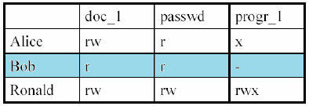
Capability Table*
This is a row in the access matrix
Bound to subjects, lists what permissions a subject has to each object
NOT an ACL.. In fact the opposite

Slide 135
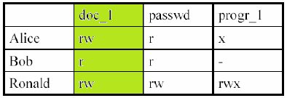
ACL*
It’s a column of an access matrix
Lists what (and how) subjects may access a certain object.

Slide 136
Content Dependant Access Controls
Access is determined by the type of data.
Example, email filters that look for specific things like “confidential”, “SSN”, images.
Web Proxy servers may be content based.

Slide 137
Context Dependant Access Control
System reviews a Situation then makes a decision on access.
A firewall is a great example of this, if session is established, then allow traffic to proceed.
In a web proxy, allow access to certain body imagery if previous web sessions are referencing medical data otherwise deny access.

Slide 138
Summary of Access Control Techniques
Access control techniques are used to support the access control models.
Access control matrix: Table of subjects and objects that outlines their access relationships
Access control list: Bound to an object and indicates what subjects can access it and what operations they can carry out
Capability table: Bound to a subject and indicates what objects that subject can access and what operations it can carry out
Content-based access: Bases access decisions on the sensitivity of the data, not solely on subject identity
Context-based access: Bases access decisions on the state of the situation, not solely on identity or content sensitivity
Restricted interface: Limits the user’s environment within the system, thus limiting access to objects
Rule-based access: Restricts subjects’ access attempts by predefined rule

Slide 139
Access Control Layers

Slide 140
Controls and Control Types*
There are Controls and Control types, need to understand these.
Controls:
Administrative
Physical
Technical

Slide 141
Administrative Controls
HR practices
Management practices (supervisor, corrective actions)
Training
Testing – not technical, and management’* responsibility to ensure it happens

Slide 142
Physical Controls
Physical Network Segregation (not logical) – ensure certain networks segments are physically restricted
Perimeter Security – CCTV, fences, security guards, badges
Computer Controls – physical locks on computer equipment, restrict USB access etc.
Work Area Separation – keep accountants out of R&D areas
Cabling – shielding, Fiber
Control Zone – break up office into logical areas (lobby – public, R&D- Top Secret, Offices – secret)

Slide 143
Technical or Logical controls
Using technology to protect
System Access – Kerberos, PKI, radius (specifically access to a system)
Network Architecture – IP subnets, VLANS , DMZ
Network Access – Routers, Switches and Firewalls that control access
Encryption – protect confidentiality, integrity
Auditing – logging and notification systems.

Slide 144
Summary of Access Control Layers
Administrative Controls
Policy and procedures
Personnel controls
Supervisory structure
Security-awareness training
Testing
Physical Controls
Network segregation
Perimeter security
Computer controls
Work area separation
Data backups
Cabling
Control zone
Technical Controls
System access
Network architecture
Network access
Encryption and protocols
Auditing
Notes:
Access control consists of three broad categories: administrative, technical, and physical. Each category has different access control mechanisms that can be carried out manually or automatically. All of these access control mechanisms should work in concert with each other to protect an infrastructure and its data. Each category of access control has several components that fall within it, as shown next: • Administrative Controls • Policy and procedures • Personnel controls • Supervisory structure • Security-awareness training • Testing • Physical Controls • Network segregation • Perimeter security • Computer controls • Work area separation • Data backups • Cabling • Control zone • Technical Controls • System access • Network architecture • Network access • Encryption and protocols • Auditing
Harris, Shon (2012-11-08). CISSP All-in-One Exam Guide, 6th Edition (Kindle Locations 5267-5269). McGraw-Hill Education. Kindle Edition.
Harris, Shon (2012-11-08). CISSP All-in-One Exam Guide, 6th Edition (Kindle Locations 5260-5267). McGraw-Hill Education. Kindle Edition.

Slide 145
Threats to Access Control

Slide 146
Threats to Access Control
Let’s review these now
Dictionary attacks
Sniffers
Dictionary attack.
Brute force attacks
Spoofing login/trusted path
Phishing
Identity theft

Slide 147
Top 10 Password Cracking Methods
http://www.alphr.com/features/371158/top-ten-password-cracking-techniques

Slide 148
Top 10 Password Cracking Methods
1. Dictionary attack – e.g. “password”
2. Brute force attack – e.g. “a, aa, ab, ac…”
3. Rainbow table attack – precomputed hashes
4. Phishing – typically email
5. Social engineering – e.g. phone call
6. Malware – e.g. from websites
7. Offline cracking – taking time
8. Shoulder surfing – watching
9. Spidering – slurping open sources
10. Guess – intelligent deduction
Notes:
1. Dictionary attack
This uses a simple file containing words that can, surprise surprise, be found in a dictionary. In other words, if you will excuse the pun, this attack uses exactly the kind of words that many people use as their password.
Cleverly grouping words together such as ‘letmein’ or ‘superadministratorguy’ will not prevent your password from being cracked this way - well, not for more than a few extra seconds.
2. Brute force attack
This method is similar to the dictionary attack but with the added bonus, for the hacker, of being able to detect non-dictionary words by working through all possible alpha-numeric combinations from aaa1 to zzz10.
It’s not quick, provided your password is over a handful of characters long, but it will uncover your password eventually. Brute force attacks can be shortened by throwing additional computing horsepower, in terms of both processing power - including harnessing the power of your video card GPU - and machine numbers, such as using distributed computing models and zombie botnets.
3. Rainbow table attack
A rainbow table is a list of pre-computed hashes - the numerical value of an encrypted password, used by most systems today - and that’s the hashes of all possible password combinations for any given hashing algorithm mind. The time it takes to crack a password using a rainbow table is reduced to the time it takes to look it up in the list.
Blogs
How a cheap graphics card could crack your password in under a second
However, the table itself will be huge and require some serious computing horse power to run, and it’s useless if the hash it is trying to find has been ‘salted’ by adding random characters to the password before applying the hashing algorithm.
There is talk of salted rainbow tables existing, but these would be so large as to be difficult to use in practise. They would likely only work with a predefined ‘random character’ set and password strings below 12 characters as the size of the table would be prohibitive to even state-level hackers otherwise.
4. Phishing
There's an easy way to hack: ask the user for his or her password. A phishing email leads the unsuspecting reader to a faked online banking, payment or other site in order to login and put right some terrible problem with their security.
Why bother going to the trouble of cracking the password when the user will happily give it you anyway?
5. Social engineering
Social engineering takes the whole ‘ask the user’ concept outside of the inbox that phishing tends to stick with and into the real world.
A favourite of the social engineer is to telephone an office posing as an IT security tech guy and simply ask for the network access password. You’d be amazed how often this works. Some even have the necessary gonads to don a suit and name badge before walking into a business to ask the receptionist the same question face to face.
The most confident of hackers will take the guise of a parcel courier, aircon service technician or anything else that gets them access to an office building.
Once they are in, the service personnel ‘uniform’ provides a kind of free pass to wander around unhindered, and make note of passwords being entered by genuine members of staff. It also provides an excellent opportunity to eyeball all those post-it notes stuck to the front of LCD screens with logins scribbled upon them.
6. Malware
A key logger or screen scraper can be installed by malware which records everything you type or takes screen shots during a login process, and then forwards a copy of this file to hacker central.
Some malware will look for the existence of a web browser client password file and copy this which, unless properly encrypted, will contain easily accessible saved passwords from the user's browsing history.
7. Offline cracking
It’s easy to imagine that passwords are safe when the systems they protect lock out users after three or four wrong guesses, blocking automated guessing applications. Well, that would be true if it were not for the fact that most password hacking takes place offline, using a set of hashes in a password file that has been ‘obtained’ from a compromised system.
Often the target in question has been compromised via an hack on a third party, which then provides access to the system servers and those all-important user password hash files. The password cracker can then take as long as they need to try and crack the code without alerting the target system or individual user.
8. Shoulder surfing
The most confident of hackers will take the guise of a parcel courier, aircon service technician or anything else that gets them access to an office building.
Once they are in, the service personnel ‘uniform’ provides a kind of free pass to wander around unhindered, and make note of passwords being entered by genuine members of staff. It also provides an excellent opportunity to eyeball all those post-it notes stuck to the front of LCD screens with logins scribbled upon them.
9. Spidering
Savvy hackers have realised that many corporate passwords are made up of words that are connected to the business itself. Studying corporate literature, website sales material and even the websites of competitors and listed customers can provide the ammunition to build a custom word list to use in a brute force attack.
Really savvy hackers have automated the process and let a spidering application, similar to those employed by leading search engines to identify keywords, collect and collate the lists for them.
10. Guess
The password crackers best friend, of course, is the predictability of the user. Unless a truly random password has been created using software dedicated to the task, a user generated ‘random’ password is unlikely to be anything of the sort.
Instead, thanks to our brains' emotional attachment to things we like, the chances are those random passwords are based upon our interests, hobbies, pets, family and so on. In fact, passwords tend to be based on all the things we like to chat about on social networks and even include in our profiles. Password crackers are very likely to look at this information and make a few - often correct - educated guesses when attempting to crack a consumer-level password without resorting to dictionary or brute force attacks.

Slide 149
Final Thoughts

Slide 150
Final Thoughts

Slide 151
From Authorities to Audits
Examples
Technical, physical, and administrative requirements that must be in place to ensure compliance with the authorities
Statements of how a company will implement and enforce requirements
Implementation of the technical, physical, and administrative requirements found in the policy statements
Verification of appropriately implemented controls to comply with requirements
PCI
HIPAA
NERC
Authorities
Requirements
Policies
Controls
Audits
PCI-DSS Example
Authority: PCI-DSS is the authority document created by the PCI-SSC.
Requirement: (10.6) Review logs for all system components at least daily.
Policy: Monitoring Policy – States logs will be reviewed at least daily.
Control: Tool XYZ provides real-time monitoring for all system components.
Audit: Auditor verifies Tool XYZ is appropriately monitoring and alerting to actionable events. Audit results and evidence are stored as part of the audit.

Slide 152
Effectively Managed IT Controls
Technology can affect every part of the business.
At its best, technology is a competitive advantage.
At its worst, technology is your competitor’s advantage.
Product
Market Relationships
IT Controls:
Detective, protective and reactive measures in place to protect the confidentiality, integrity, and availability of business information and ensure appropriate management of the IT function to meet business objectives.
Inbound Logistics
Operations
Outbound Logistics
Marketing
and Sales
Service
Firm Infrastructure
HR Management
Margin
Procurement
Technology Development
Notes:
Compliance Control: A process, effected by management and other personnel, designed to provide reasonable assurance that transactions are executed in accordance with 1) laws governing the use of budget authority and other laws and regulations that could have a direct and material effect on the financial statements or required supplementary stewardship information and 2) any other laws, regulations, and government wide policies identified in OMB audit guidance. [GAO/PCIE Financial Audit Manual]
Source: http://www.unifiedcompliance.com/it_compliance/language_compliance/definitions/c.html

Slide 153
Chris Davis
UTD Email: cmd140430@utdallas.edu
Google Voice: 214-771-8122
Course Materials
https://elearning.utdallas.edu

Slide 154
Additional Materials

Slide 155

Today's Materials
Harris, Shon (2012-11-08).
CISSP All-in-One Exam Guide, 6th Edition.
McGraw-Hill Education.

Slide 156
DAC vs. MAC vs. RBAC
DAC
MAC
ABAC
Discretionary Access Control
Mandatory Access Control
Attribute-Based Access Control
SUBJECTS
ATTRIBUTES
ATTRIBUTES
ATTRIBUTES
REQUESTING HUMAN, USER, OR NON-PERSON-ENTITY (NPE)
OBJECTS
ATTRIBUTES
ATTRIBUTES
RESOURCE OR ENTITY TO BE PROTECTED FROM ACCESS
EVIRONMENT
ATTRIBUTES
DYNAMIC FACTORS, INDEPENDENT OF SUBJECT AND OBJECT
?
Reference Monitor
POLICY, RULES, AND RELATIONSHIPS
Notes:
RBAC, MAC, and DAC A lot of confusion exists regarding whether RBAC is a type of DAC model or a type of MAC model. Different sources claim different things, but in fact it is a model in its own right. In the 1960s and 1970s , the U.S. military and NSA did a lot of research on the MAC model . DAC, which also sprang to life in the ’60s and ’70s, has its roots in the academic and commercial research laboratories. The RBAC model, which started gaining popularity in the 1990s, can be used in combination with MAC and DAC systems. For the most up-to-date information on the RBAC model, go to http:// csrc.nist.gov/ rbac, which has documents that describe an RBAC standard and independent model, with the goal of clearing up this continual confusion. In reality, operating systems can be created to use one, two, or all three of these models in some form, but just because they can be used together does not mean that they are not their own individual models with their own strict access control rules.
Harris, Shon (2012-11-08). CISSP All-in-One Exam Guide, 6th Edition (Kindle Locations 4988-4992). McGraw-Hill Education. Kindle Edition.

Slide 157
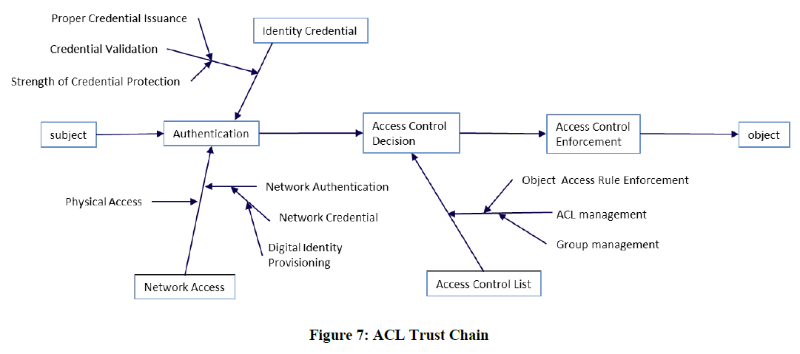
Access Control List Trust Chain
Notes:
Attribute-Based Access Control (ABAC) is a logical
access control methodology where an authorization to
perform a set of operations is determined by evaluating the
attributes associated with the subject, object, requested
operations, and, in some cases, environment conditions
against policy, rules, or relationships that describe the
allowable operations for a given set of attributes. ABAC
represents a point on the spectrum of logical access control,
from simple access control lists to more capable role-based
access (RBAC), and finally, to a highly flexible method for
providing access based on the evaluation of attributes.
There has not been a comprehensive effort to formally
define or guide the implementation of ABAC within the
Federal Government. This research provides considerations
for using ABAC to improve information sharing within and
among organizations, while maintaining control of that
information. The research serves a two-fold purpose. First,
it aims to provide federal agencies with a definition of ABAC
and a description of the functional components of ABAC.
Second, it provides planning, design, implementation, and
operational considerations for employing ABAC within a
large enterprise with the goal of improving information
sharing while maintaining control of that information.
In addition to the core concept (i.e. definition and
consideration), ABAC research includes technologies such
as attribute assurance, attribute engineering/management,
identity system integration, attribute federation, situational
awareness (real time or contextual) mechanism, policy
management, and natural-language policy translation to
digital policy.
In FY 2014, CSD published SP 800-162, Guide to
Attribute Based Access Control (ABAC) Definition and
Considerations. SP 800-162 includes terminology and basic
understanding of ABAC; ABAC enterprise-employment
considerations during the initiation, acquisition/development,
implementation/assessment, and operations and
maintenance phases; and an example to demonstrate how
ABAC is implemented in a Web Information Portal. CSD also
researched ABAC formal models; the result will be presented
in a NISTIR that will describe a variety of characteristics
and applications of ABAC formal models. CSD also started
research on the Attribute Assurance of ABAC in partnership
with the National Security Agency (NSA), the National
Strategy for Trusted Identities in Cyberspace (NSTIC), and
the National Cybersecurity Center of Excellence (NCCoE);
CSD developed a white paper based on the mechanism for
defining the levels of assurance of ABAC attributes, as well
as collecting use cases, current standards, and engineering
experiences through a Request for Information (RFI) and
working with ABAC user/commercial product communities.
In FY 2015, CSD will continue the research of ABAC
formal models, as well as details and extended topics of
ABAC capabilities, such as Attribute Assurance, ABAC
implementation examples, and ABAC standards.

Slide 158
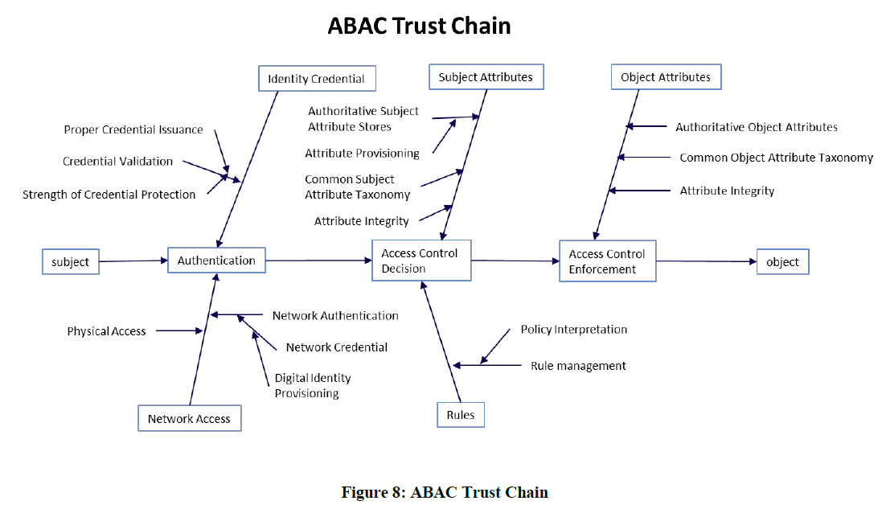
Attribute-Based Access Control Trust Chain
Notes:
Attribute-Based Access Control (ABAC) is a logical
access control methodology where an authorization to
perform a set of operations is determined by evaluating the
attributes associated with the subject, object, requested
operations, and, in some cases, environment conditions
against policy, rules, or relationships that describe the
allowable operations for a given set of attributes. ABAC
represents a point on the spectrum of logical access control,
from simple access control lists to more capable role-based
access (RBAC), and finally, to a highly flexible method for
providing access based on the evaluation of attributes.
There has not been a comprehensive effort to formally
define or guide the implementation of ABAC within the
Federal Government. This research provides considerations
for using ABAC to improve information sharing within and
among organizations, while maintaining control of that
information. The research serves a two-fold purpose. First,
it aims to provide federal agencies with a definition of ABAC
and a description of the functional components of ABAC.
Second, it provides planning, design, implementation, and
operational considerations for employing ABAC within a
large enterprise with the goal of improving information
sharing while maintaining control of that information.
In addition to the core concept (i.e. definition and
consideration), ABAC research includes technologies such
as attribute assurance, attribute engineering/management,
identity system integration, attribute federation, situational
awareness (real time or contextual) mechanism, policy
management, and natural-language policy translation to
digital policy.
In FY 2014, CSD published SP 800-162, Guide to
Attribute Based Access Control (ABAC) Definition and
Considerations. SP 800-162 includes terminology and basic
understanding of ABAC; ABAC enterprise-employment
considerations during the initiation, acquisition/development,
implementation/assessment, and operations and
maintenance phases; and an example to demonstrate how
ABAC is implemented in a Web Information Portal. CSD also
researched ABAC formal models; the result will be presented
in a NISTIR that will describe a variety of characteristics
and applications of ABAC formal models. CSD also started
research on the Attribute Assurance of ABAC in partnership
with the National Security Agency (NSA), the National
Strategy for Trusted Identities in Cyberspace (NSTIC), and
the National Cybersecurity Center of Excellence (NCCoE);
CSD developed a white paper based on the mechanism for
defining the levels of assurance of ABAC attributes, as well
as collecting use cases, current standards, and engineering
experiences through a Request for Information (RFI) and
working with ABAC user/commercial product communities.
In FY 2015, CSD will continue the research of ABAC
formal models, as well as details and extended topics of
ABAC capabilities, such as Attribute Assurance, ABAC
implementation examples, and ABAC standards.

Slide 159
SESAME
European technology, developed to extend Kerberos and improve on it’s weaknesses
Sesame uses both symmetric and asymmetric cryptography.
Uses “Privileged Attribute Certificates” rather than tickets, PACS are digitally signed and contain the subjects identity, access capabilities for the object, access time period and lifetime of the PAC.
PACS come from the Privileged Attribute Server.
Notes:
Kerberos uses tickets to authenticate subjects to objects, whereas SESAME uses Privileged Attribute Certificates (PACs), which contain the subject’s identity, access capabilities for the object , access time period, and lifetime of the PAC. The PAC is digitally signed so the object can validate it came from the trusted authentication server, which is referred to as the Privileged Attribute Server (PAS). The PAS holds a similar role to that of the KDC within Kerberos. After a user successfully authenticates to the authentication service (AS), he is presented with a token to give to the PAS. The PAS then creates a PAC for the user to present to the resource he is trying to access. Figure 3-13 shows a basic overview of the SESAME process.
Harris, Shon (2012-11-08). CISSP All-in-One Exam Guide, 6th Edition (Kindle Locations 4738-4743). McGraw-Hill Education. Kindle Edition.

Slide 160
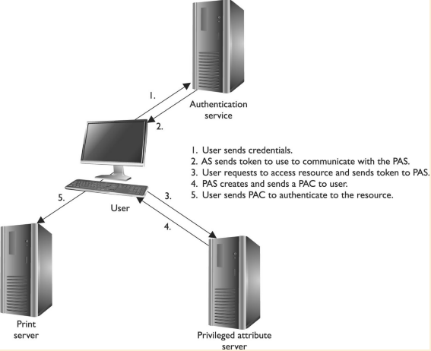
SESAME

Slide 161
Access Control Administration

Slide 162
Centralized Access Control Administration
What is it?
A centralized place for configuring and managing access control
All the ones we will talk about (next) are “AAA” protocols*
Authentication
Authorization
Auditing

Slide 163
Centralized Access Control Technologies
We will talk about each of these in the upcoming slides
Radius
TACACS, TACACS+
Diameter

Slide 164
Radius*
Initially developed by Livingston to authenticate modem users
Access Server sends credentials to Radius server. Which sends back authorization and connection parameters (IP address etc) (see slide)
Can use multiple authentication type (PAP, CHAP, EAP)
Uses UDP port 1812 , and auditing 1813*
Sends Attribute Value Pair (Ex. IP=192.168.1.1)
Access server notifies Radius server on disconnect (for auditing)
Notes:
Remote Authentication Dial-In User Service (RADIUS) is a network protocol that provides client/ server authentication and authorization , and audits remote users. A network may have access servers, a modem pool, DSL, ISDN, or T1 line dedicated for remote users to communicate through. The access server requests the remote user’s logon credentials and passes them back to a RADIUS server, which houses the usernames and password values. The remote user is a client to the access server, and the access server is a client to the RADIUS server.
Harris, Shon (2012-11-08). CISSP All-in-One Exam Guide, 6th Edition (Kindle Locations 5131-5134). McGraw-Hill Education. Kindle Edition.

Slide 165
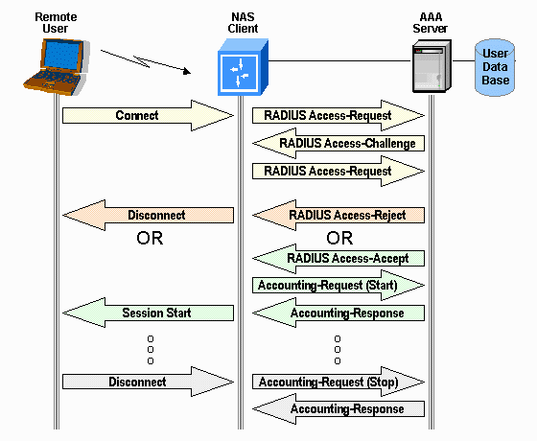
Radius

Slide 166
What is radius used for
Network access
Dial up
VLAN provisioning
IP address assignment
801.x access control

Slide 167
Radius Pros/Cons
Radius Pros
It’s been around, a lot of vendor support
Radius Cons
Radius can share symmetric key between NAS and Radius server, but does not encrypt attribute value pairs, only user info. This could provide info to people doing reconnaissance
PAP password go clear text from dial up user to NAS

Slide 168
TACACS+
Provides the same functionality of Radius
TACACS+ uses TCP port 49
TACACS+ can support one time passwords
Encrypts ALL traffic data
TACACS+ separates each AAA function.
For example can use an AD for authentication, and an SQL server for accounting.

Slide 169
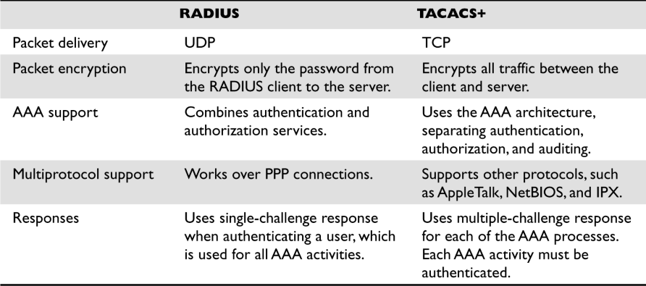
RADIUS vs. TACACS+

Slide 170
Diameter
Builds upon Radius
Similar functionality to Radius and TACACS+
NOT Backwards compatible with Radius (book is wrong) but is similar and an upgrade path
Uses TCP on port 3868
With Diameter the DS can connect to the NAS (i.e.. Could say kick user off now). Radius servers only respond to client requests.

Slide 171
Centralized Access Controls overview
Idea centralize access control
Radius, TACACS+, diameter
Decentralized is simply maintaining access control on all nodes separately.

Slide 172
Unauthorized Disclosure of Information

Slide 173
Unauthorized Disclosure of Information
Sometimes data is un-intentionally released.
Examples:
Object reuse
Countermeasures
Destruction
Degaussing
overwriting
Emanations Security (next)

Slide 174
Emanation Security
All devices give off electrical / magnetic signals.
A non-obvious example is reading info from a CRT bouncing off something like a pair of sunglasses.
Tempest* is a standard to develop countermeasures to protect against this.
Notes:
NOTE TEMPEST is the name of a program, and now a standard, that was developed in the late 1950s by the U.S. and British governments to deal with electrical and electromagnetic radiation emitted from electrical equipment, mainly computers. This type of equipment is usually used by intelligence, military, government , and law enforcement agencies , and the selling of such items is under constant scrutiny.
Harris, Shon (2012-11-08). CISSP All-in-One Exam Guide, 6th Edition (Kindle Locations 5549-5552). McGraw-Hill Education. Kindle Edition.

Slide 175
Emanation Countermeasures
Faraday cage – a metal mesh cage around an object, it negates a lot of electrical/magnetic fields.
White Noise – a device that emits uniform spectrum of random electronics signals. You can buy sounds frequency white noise machines. (call centers, doctors)
Control Zones – protect sensitive devices in special areas with special walls etc.

Slide 176
Access Control Monitoring

Slide 177
IDS
IDS are a tool in a layered security model. The purpose of an IDS is to
identify suspicious activity
log activity
Respond (alert people)

Slide 178
IDS categories
IDS systems we are about to discuss.
HIDS – Host Based Intrusion Detection System
NIDS – Network Intrusion Detection System

Slide 179
IDS Components
Both type of IDS have several components that make up the product
Sensor – Data Collector
On network segments (NIDS)
Or on Hosts (HIDS)
Analysis Engine – Analyzes data collected by the sensor, determines if there is suspicious activity
Signature Database – Used by the AE, defines signatures of previously known attacks
User Interface and Reporting – the way the system interacts with users
(visualization next)

Slide 180
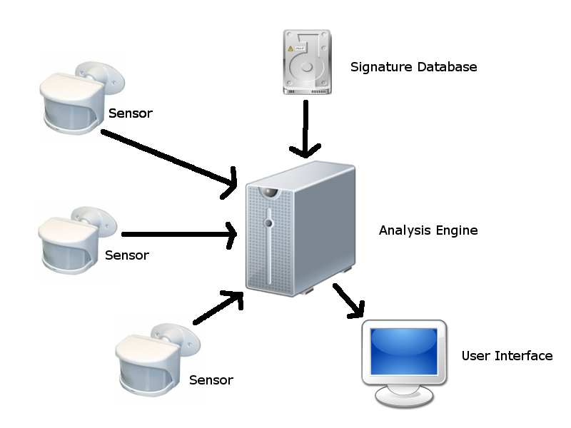
IDS Components

Slide 181
HIDS
Hosts Based Intrusion Detection Systems – Examine the operation of a SINGLE system independently to determine of anything “of note” is going on.
Some things a HIDS will looks at
Logins
System Log files / audit files
Application Log Files / audit files
File Activity / Changes to software
Configuration Files changes
Processes being launched or stopped
Use of certain programs
CPU usage
Network Traffic to/from Computer

Slide 182
Advantages of HIDS
Can be operating system and application specific – might understand the latest attack against a certain service on a host.
They can look at data after it’s been decrypted (network traffic is often encrypted)*

Slide 183
Disadvantages of HIDS
Only protect one machine (or must be loaded on every machine you want to protect)
Use local system resources (CPU/memory)
They don’t see what’s going on, on other machines.
Scalability
The HIDS could be disabled if machine is hacked

Slide 184
HIDS side note
Logs in Unix are generally sent via the syslog mechanism to a series of files.
In Unix you also have a kernel ring buffer
In Windows you have the event viewer which you can view logs by Application, System, and Security other categories may be added.

Slide 185
Network Based IDS
A concept focused on watching an entire network and all associated machines. Focuses specifically on network traffic, in this case the “sensor” is sometimes called a “traffic collector”
Looks at
SRC IP
DEST IP
Protocol
Port Numbers
Data Content

Slide 186
Network Based IDS
A NIDS system will often look for
DoS Attacks
Port Scans
Malicious content
Vulnerability tests
Tunneling
Brute Force Attacks

Slide 187
Network Based IDS
In Addition to looking for attacks a NIDS can watch the internal network for policy violations.
Example:
Detecting Instant Messaging, or streaming video.

Slide 188
NIDS Advantages
A single NIDS sensor can cover a whole network. What happens if I want to cover multiple networks?
Deployment is usually easier
A NIDS can see things that are happening on multiple machine, it gets a bigger picture and may see distributed attacks that a HIDS would miss

Slide 189
NIDS problems
Data must be UNENCRYPTED for a NIDS to analyze. So many protocols are now encrypted, it’s hard for the NIDS to see what’s going on.*
Switches cause problems for NIDS.
If only on the perimeter, it can miss things on the inside.
It must be able to handle LOTS of data to be effective! (should be able to handle wire speed+)
It does not see what’s going on a server directly

Slide 190
IDS vs. IPS
An IDS is generally a passive device.
An IPS is an IDS that takes an active aproach.
Examples:
Activate Firewall rules dynamically
Shuts down TCP traffic

Slide 191
Signature Based
Most network attacks have distinct “signatures” that is data that is passed between attacker and victim. A Signature Based NIDS has a database of known attack signatures, and compares network traffic against this database.
Concerns for Singature Based systems.
Pay for a signature subscription from vendor*
Keep signatures updated*
Does not protect against 0day attacks!

Slide 192
Anomaly based IDS
Example.
You have a 15 year old son. Everyday he normally comes home at 3:30 does his homework watches TV. All of a sudden he starts “hanging out at school” till 5PM, comes home, does homework, then disappears into his room and talks on the phone till 9:30PM

Slide 193
Anomaly
Anomaly based system, look for changes in “normal” behavior. To do this generally you let a anomaly based system learn what normal behavior is over a few days or weeks, creating a baseline. The anomaly based system will then look for traffic types and volume that is outside of the normal behavior.

Slide 194
Anomaly
Advantages
Can possibly detect 0days*
Can detect behavioral changes that might not be technical attacks (like employees preparing to commit fraud)*
Disadvantages
Lots of false positives*
Often ignored due to reason above
Requires a much more skilled analyst

Slide 195
Rules Based
Uses expert system/knowledge based systems.
These use a database of knowledge and an “inference engine”) to try to mimic human knowledge. It’s like of a person was watching data in real time and had knowledge of how attacks work.

Slide 196
Random Term #1
Promiscuous mode
Network interfaces generally only look at packets specifically intended for their MAC address. TO accomplish sniffing, network analysis, or IDS functionality, you have to put network interfaces into promiscuous mode

Slide 197
Random Term #2
Switched Port Analyzer (SPAN) or (Mirror port) – to get around the problem IDS system in a switched network.
Configure your switch to copy all traffic down to the SPAN port where your IDS system sits.

Slide 198
Random Term #3
Network Tap – a piece of hardware that lets a device ONLY see what’s going on in the network, it doesn’t allow for outgoing traffic.
In the case of an IDS, you might put a TAP on the IDS to stop someone from hacking the IDS.

Slide 199
Random Term #4
Network Mapper – a tool used to discover devices and Operating Systems that are on a network.

